Slide 1
Histone Structure
I. Current Concepts
Ken Biegeleisen, M.D., Ph.D.
www.NotAHelix.com
©2013, all rights reserved

Slide 2
Most of the virtual structure files in this project were created in Maestro, a component of the Schrödinger Suite, which was kindly made available by Schrödinger, Inc. (www.schrodinger.com). Most of the graphics were created from pdb files via DS Visualizer, a product of Accelrys (www.accelrys.com), which, incredibly, is freeware.

Slide 3
Table of Contents
NOTE: MOST SLIDES HAVE A LINK TO RETURN TO THIS PAGE
Introduction
“Heroes of the histone octamer”
Futility of working without ribbons
Addition of ribbons; introduction to octamer structure
Structure of the histone monomer; the “histone fold”
Other α-helices (in addition to Helices I, II and III)
Dimers
Geometry of the [H3-H4]₂ tetramer
What holds the octamer together? 1. H3-H3 interactions.
What holds the octamer together? 2. H3-H4 interactions.
Completion of the octamer: Addition of H2A-H2B dimers
Can the octamer structure be logically extended to a dimer?
X-axis, y-axis and z-axis rotation of histone octamer (movies)
Superhelical ramp
Atomic view of histone-DNA contacts in the Superhelical Ramp

Slide 4
Introduction
Table of Contents

Slide 5

Hello. I’m Dr. Ken Biegeleisen. I'm going to show you the structure of the histone octamer as currently portrayed in all textbooks of molecular biology. Then I'm going to show you a modification of that structure, which adds order to the currently-disordered N-termini of its eight subunits.
This presentation is divided into three parts. Here, in Part I, I shall do no more than to review the current histone structure model. If you're interested in the eukaryotic cell nucleus, I think you'll find this to be quite enjoyable. I've gone to a lot of trouble to create 3D animations which should provide insight into this remarkable protein complex; an insight that cannot be had by simply staring at flat drawings.
Nor can the histone octamer be comprehended by simply spinning around a virtual model of the whole thing, using Jmol or comparable programs, especially if the virtual model is of the entire nucleosome, which also includes the DNA, further obscuring the intricate and highly-ordered state of the octamer core.
Hello. I’m Dr. Ken Biegeleisen. I'm going to show you the structure of the histone octamer as currently portrayed in all textbooks of molecular biology. Then I'm going to show you a modification of that structure, which adds order to the currently-disordered N-termini of its eight subunits.
This presentation is divided into three parts. Here, in Part I, I shall do no more than to review the current histone structure model. If you're interested in the eukaryotic cell nucleus, I think you'll find this to be quite enjoyable. I've gone to a lot of trouble to create 3D animations which should provide insight into this remarkable protein complex; an insight that cannot be had by simply staring at flat drawings.
Nor can the histone octamer be comprehended by simply spinning around a virtual model of the whole thing, using Jmol or comparable programs, especially if the virtual model is of the entire nucleosome, which also includes the DNA, further obscuring the intricate and highly-ordered state of the octamer core.
Table of Contents
Notes:
<Slide 5-original.mp3> NOTE: The new <Slide 5.mp3> contains the Flash control instructions, which are omitted from this version. The revised Slide 5, with Flash control instructions, is found in the nearly-identical PowerPoint presentation <histone_structure_current.pptx>, located in the <iSpring> directory.

Slide 6
Heroes of the Histone Octamer
1. Roger Kornberg
Kornberg RD, Thomas JO. Chromatin structure; oligomers of the histones. Science. 1974 May 24;184(4139):865-8.
PMID: 4825888. DOI: 10.1126/science.184.4139.865
Kornberg RD. Chromatin structure: a repeating unit of histones and DNA.
Science. 1974 May 24;184(4139):868-71.
PMID: 4825889.
2. Luger, K., Mader, A.W., Richmond, R.K., Sargent, D.F., Richmond, T.J.
Crystal structure of the nucleosome core particle at 2.8 A resolution.
Nature, 1997; 389: 251-260. PubMed: 9305837 . DOI: 10.1038/38444
3. van Holde, K.E. Chromatin. New York: Springer-Verlag, 1989.
ISBN-13: 978-0387966946. DOI: 10.1016/0092-8674(89)90284-5
Table of Contents

Slide 7
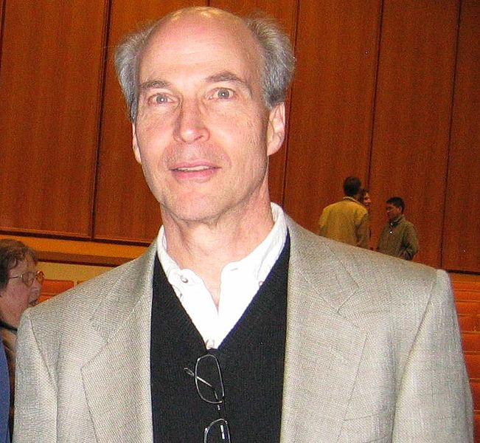
Heroes of the Histone Octamer
1. Roger Kornberg
Kornberg RD, Thomas JO. Chromatin structure; oligomers of the histones. Science. 1974 May 24;184(4139):865-8.
PMID: 4825888. DOI: 10.1126/science.184.4139.865
Kornberg RD. Chromatin structure: a repeating unit of histones and DNA.
Science. 1974 May 24;184(4139):868-71.
PMID: 4825889.
2. Luger, K., Mader, A.W., Richmond, R.K., Sargent, D.F., Richmond, T.J.
Crystal structure of the nucleosome core particle at 2.8 A resolution.
Nature, 1997; 389: 251-260. PubMed: 9305837 . DOI: 10.1038/38444
3. van Holde, K.E. Chromatin. New York: Springer-Verlag, 1989.
ISBN-13: 978-0387966946. DOI: 10.1016/0092-8674(89)90284-5
Table of Contents

Slide 8
Heroes of the Histone Octamer
Heroes of the Histone Octamer
1. Roger Kornberg
Kornberg RD, Thomas JO. Chromatin structure; oligomers of the histones. Science. 1974 May 24;184(4139):865-8.
PMID: 4825888. DOI: 10.1126/science.184.4139.865
Kornberg RD. Chromatin structure: a repeating unit of histones and DNA.
Science. 1974 May 24;184(4139):868-71.
PMID: 4825889.
1. Roger Kornberg
Kornberg RD, Thomas JO. Chromatin structure; oligomers of the histones. Science. 1974 May 24;184(4139):865-8.
PMID: 4825888. DOI: 10.1126/science.184.4139.865
Kornberg RD. Chromatin structure: a repeating unit of histones and DNA.
Science. 1974 May 24;184(4139):868-71.
PMID: 4825889.
2. Luger, K., Mader, A.W., Richmond, R.K., Sargent, D.F., Richmond, T.J.
Crystal structure of the nucleosome core particle at 2.8 A resolution.
Nature, 1997; 389: 251-260. PubMed: 9305837 . DOI: 10.1038/38444
2. Luger, K., Mader, A.W., Richmond, R.K., Sargent, D.F., Richmond, T.J.
Crystal structure of the nucleosome core particle at 2.8 A resolution.
Nature, 1997; 389: 251-260. PubMed: 9305837 . DOI: 10.1038/38444
3. van Holde, K.E. Chromatin. New York: Springer-Verlag, 1989.
ISBN-13: 978-0387966946. DOI: 10.1016/0092-8674(89)90284-5
3. van Holde, K.E. Chromatin. New York: Springer-Verlag, 1989.
ISBN-13: 978-0387966946. DOI: 10.1016/0092-8674(89)90284-5
Table of Contents
Table of Contents

Slide 9

Heroes of the Histone Octamer
1. Roger Kornberg
Kornberg RD, Thomas JO. Chromatin structure; oligomers of the histones. Science. 1974 May 24;184(4139):865-8.
PMID: 4825888. DOI: 10.1126/science.184.4139.865
Kornberg RD. Chromatin structure: a repeating unit of histones and DNA.
Science. 1974 May 24;184(4139):868-71.
PMID: 4825889.
2. Luger, K., Mader, A.W., Richmond, R.K., Sargent, D.F., Richmond, T.J.
Crystal structure of the nucleosome core particle at 2.8 A resolution.
Nature, 1997; 389: 251-260. PubMed: 9305837 . DOI: 10.1038/38444
3. van Holde, K.E. Chromatin. New York: Springer-Verlag, 1989.
ISBN-13: 978-0387966946. DOI: 10.1016/0092-8674(89)90284-5
Table of Contents

Slide 10
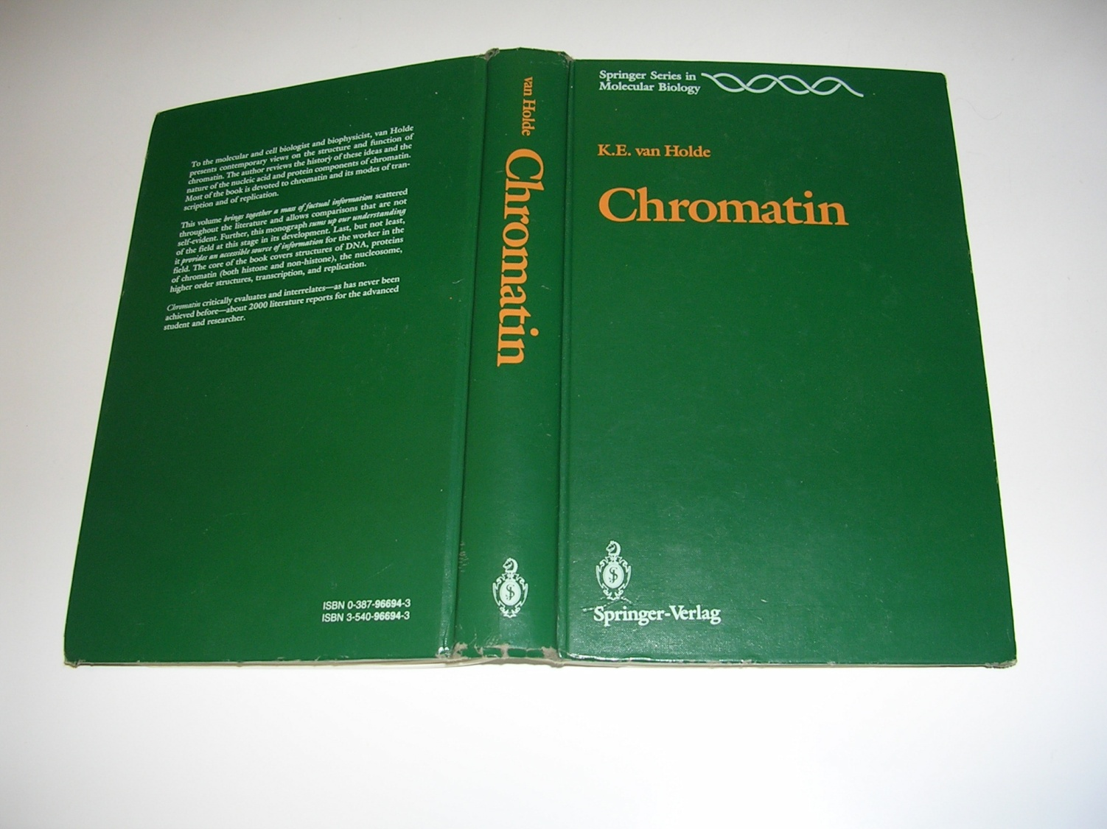
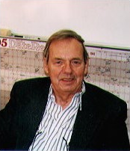
Heroes of the Histone Octamer
1. Roger Kornberg
Kornberg RD, Thomas JO. Chromatin structure; oligomers of the histones. Science. 1974 May 24;184(4139):865-8.
PMID: 4825888. DOI: 10.1126/science.184.4139.865
Kornberg RD. Chromatin structure: a repeating unit of histones and DNA.
Science. 1974 May 24;184(4139):868-71.
PMID: 4825889.
2. Luger, K., Mader, A.W., Richmond, R.K., Sargent, D.F., Richmond, T.J.
Crystal structure of the nucleosome core particle at 2.8 A resolution.
Nature, 1997; 389: 251-260. PubMed: 9305837 . DOI: 10.1038/38444
3. van Holde, K.E. Chromatin. New York: Springer-Verlag, 1989.
ISBN-13: 978-0387966946. DOI: 10.1016/0092-8674(89)90284-5
Table of Contents
Notes:
<van Holde - Chromatin.jpg>.

Slide 11
Futility of working without ribbons
Table of Contents

Slide 12
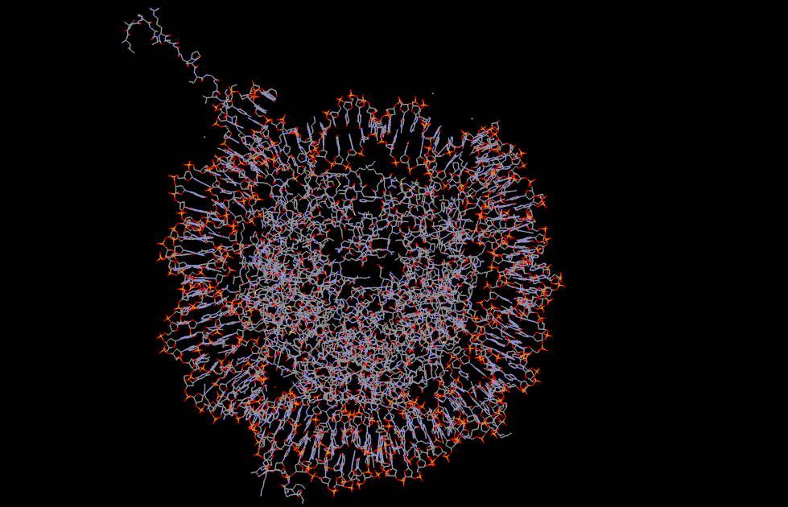
Table of Contents
Notes:
<1AOI-complete-YES_DNA.png>. This is the current concept of the “nucleosome”, an 8-subunit protein core called the “histone octamer”, with 246 bp’s of DNA wrapped around it. We can barely discern the DNA because of its recognizable helical twist and stacked bases, but looking at the protein core is like looking into a forest.

Slide 13
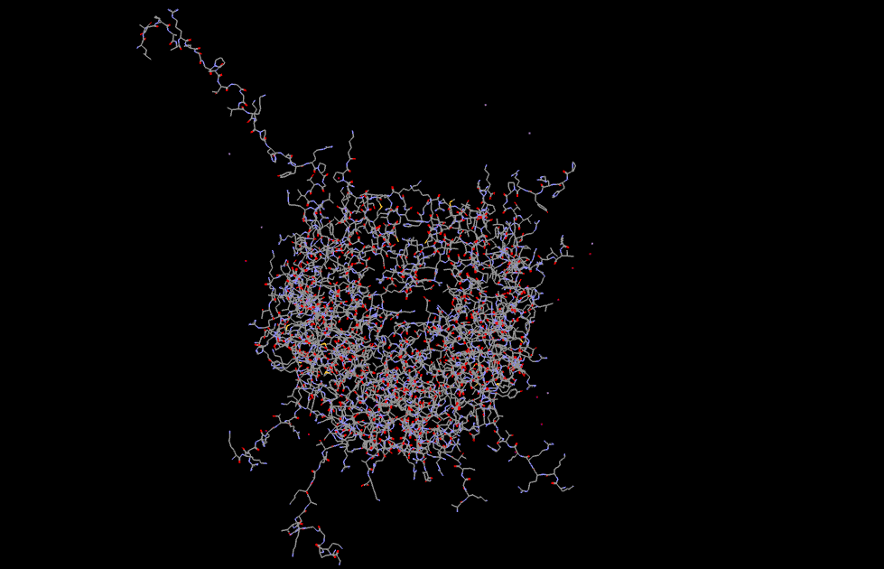
Table of Contents
Notes:
<1AOI-complete-no_DNA_1.png>. Removing the DNA does not help much. Perhaps we’ll comprehend the structure more if we move in closer?

Slide 14
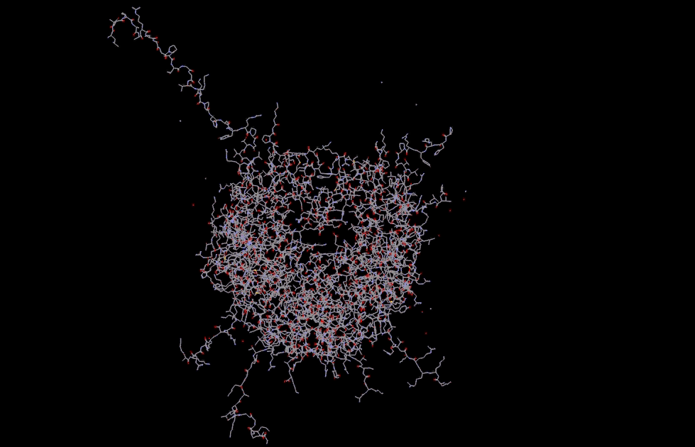
Notes:
<1aoi_no-ribbon_move-in.avi>

Slide 15
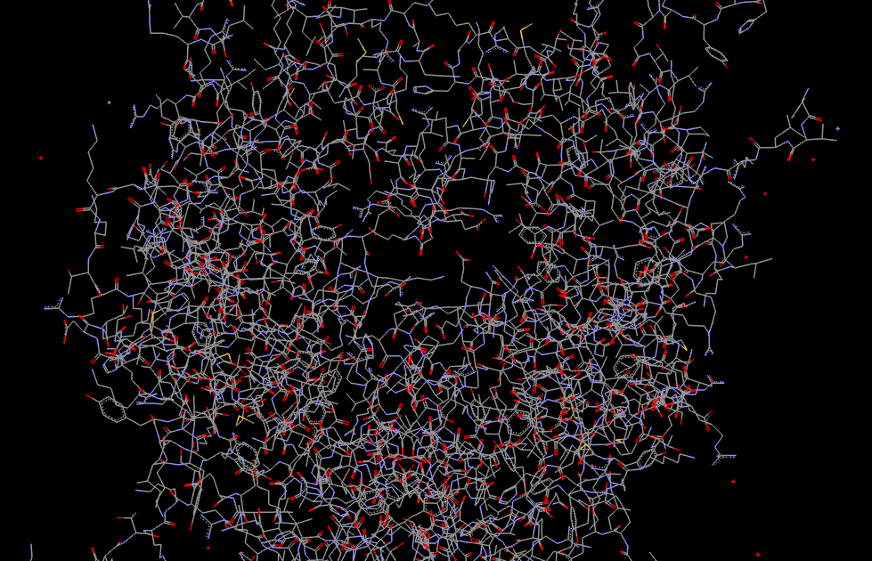
Table of Contents
Notes:
<1AOI-complete-no_DNA_8.png>. Well, that didn’t help much. And please note, we haven’t even included hydrogen atoms in our view. If we add all the hydrogen atoms...

Slide 16
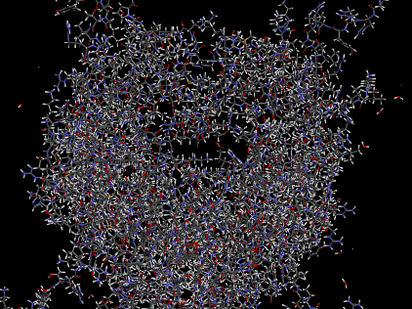
Table of Contents
Notes:
<1AOI-hydrogen-closeup.jpg>. “...we get an impenetrable thicket!”.

Slide 17
Introduction to octamer structure
Replacement of atoms by ribbons
Removal of N-terminal and C-terminal strands, leaving “truncated” octamer core.
Table of Contents

Slide 18
PDB (1aoi):
http://www.rcsb.org/pdb/explore/explore.do?structureId=1aoi
Luger, K., Mader, A.W., Richmond, R.K., Sargent, D.F., Richmond, T.J.
Crystal structure of the nucleosome core particle at 2.8 A resolution. Nature, 1997; 389: 251-260.
Notes:
<1AOI-complete-no_DNA_1.png>. We return to the original octamer-minus-DNA, and shall now replace the atoms with ribbons.

Slide 19
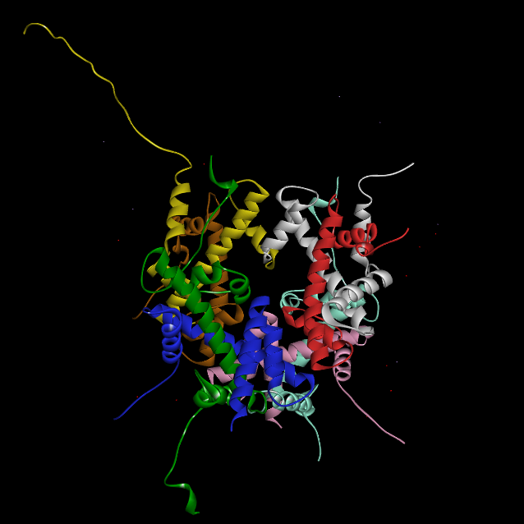
Table of Contents
Notes:
<1AOI-ribbons-no-DNA.png> Say: “Still cluttered”. Say: “Note the unruly strands; i.e., H3[a] and H3[e] have different-lengthed N-termini, yet they are known to have the same aa seq. Likewise for H2A[c] and H2A[d]”. Say: “These unruly strands are precisely what this project is all about. But not yet.

Slide 20
Table of Contents
Notes:
<1AOI-ribbons-no-DNA.png> Say: “Still cluttered”. Say: “Note the unruly strands; i.e., H3[a] and H3[e] have different-lengthed N-termini, yet they are known to have the same aa seq. Likewise for H2A[c] and H2A[d]”. Say: “These unruly strands are precisely what this project is all about. But not yet.

Slide 21
H3, H4, H2A, H2B
H3[e]
H3[a]
Table of Contents
Notes:
<1AOI-ribbons-no-DNA.png> Say: “Still cluttered”. Say: “Note the unruly strands; i.e., H3[a] and H3[e] have different-lengthed N-termini, yet they are known to have the same aa seq. Likewise for H2A[c] and H2A[d]”. Say: “These unruly strands are precisely what this project is all about. But not yet.

Slide 22
H3[e]
H3[a]
Table of Contents
Notes:
<1AOI-ribbons-no-DNA.png> Say: “Still cluttered”. Say: “Note the unruly strands; i.e., H3[a] and H3[e] have different-lengthed N-termini, yet they are known to have the same aa seq. Likewise for H2A[c] and H2A[d]”. Say: “These unruly strands are precisely what this project is all about. But not yet.

Slide 23
H4[b]
H4[f]
Table of Contents
Notes:
<1AOI-ribbons-no-DNA.png> Say: “Still cluttered”. Say: “Note the unruly strands; i.e., H3[a] and H3[e] have different-lengthed N-termini, yet they are known to have the same aa seq. Likewise for H2A[c] and H2A[d]”. Say: “These unruly strands are precisely what this project is all about. But not yet.

Slide 24
H3[e]
H3[a]
H4[b]
H4[f]
H2B[d]
H2B[h]
H2A[c]
H2A[g]
Table of Contents
Notes:
<1AOI-ribbons-no-DNA.png> Say: “Still cluttered”. Say: “Note the unruly strands; i.e., H3[a] and H3[e] have different-lengthed N-termini, yet they are known to have the same aa seq. Likewise for H2A[c] and H2A[d]”. Say: “These unruly strands are precisely what this project is all about. But not yet.

Slide 25
N
N
N
N
N
N
N
N
Table of Contents
Notes:
<1AOI-ribbons-no-DNA.png> Say: “Still cluttered”. Say: “Note the unruly strands; i.e., H3[a] and H3[e] have different-lengthed N-termini, yet they are known to have the same aa seq. Likewise for H2A[c] and H2A[d]”. Say: “These unruly strands are precisely what this project is all about. But not yet.

Slide 26
C
C
C
C
Table of Contents
Notes:
<1AOI-ribbons-no-DNA.png> Say: “Still cluttered”. Say: “Note the unruly strands; i.e., H3[a] and H3[e] have different-lengthed N-termini, yet they are known to have the same aa seq. Likewise for H2A[c] and H2A[d]”. Say: “These unruly strands are precisely what this project is all about. But not yet.

Slide 27
C
C
Table of Contents
Notes:
<1AOI-ribbons-no-DNA.png> Say: “Still cluttered”. Say: “Note the unruly strands; i.e., H3[a] and H3[e] have different-lengthed N-termini, yet they are known to have the same aa seq. Likewise for H2A[c] and H2A[d]”. Say: “These unruly strands are precisely what this project is all about. But not yet.

Slide 28
C
C
Table of Contents
Notes:
<1AOI-ribbons-no-DNA.png> Say: “Still cluttered”. Say: “Note the unruly strands; i.e., H3[a] and H3[e] have different-lengthed N-termini, yet they are known to have the same aa seq. Likewise for H2A[c] and H2A[d]”. Say: “These unruly strands are precisely what this project is all about. But not yet.

Slide 29
Table of Contents
Notes:
(See previous slide for specs). OK, let’s take off the labels, and let’s enlarge our octamer a bit. Now let’s remove all the varying N-terminal and C-terminal ends, leaving only the octamer core, which is very regular:

Slide 30
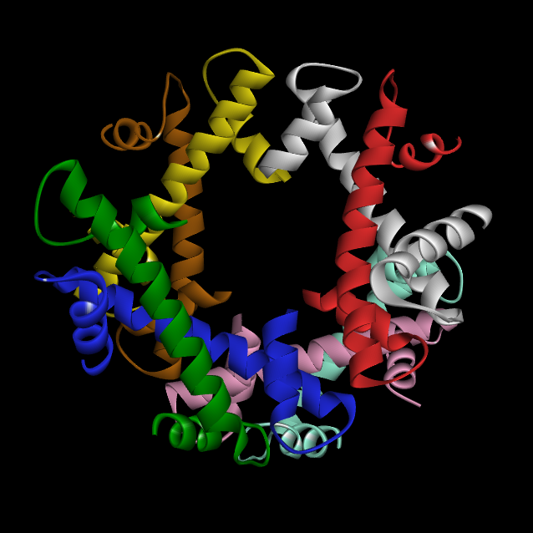
“TRUNCATED”
Table of Contents
Notes:
<Octamer_truncated.png>. Now we’re looking at the core of the octamer. Say: Something about the tetramer basis of the structure, and about how we’re going to look at that. But first, note the “inverted V” shape, which I also think of sometimes as a pyramid: We’re going to be seeing that again. NOTE: THE AUDIO FILE WAS RENAMED TO <SLIDE 30-A>.

Slide 31
“THERMODYNAMIC”
H3[e]
H3[a]
H4[f]
H4[b]
Table of Contents
Notes:
<Octamer_truncated.png>. Now we’re looking at the core of the octamer. Say: Something about the tetramer basis of the structure, and about how we’re going to look at that. But first, note the “inverted V” shape, which I also think of sometimes as a pyramid: We’re going to be seeing that again. THE AUDIO FILE WAS RENAMED TO <SLIDE 30-B>.

Slide 32
“Logical tetramer” = {H3 + H4 + H2A + H2B}
Table of Contents
Notes:
<Octamer_truncated.png>. Now we’re looking at the core of the octamer. Say: Something about the tetramer basis of the structure, and about how we’re going to look at that. But first, note the “inverted V” shape, which I also think of sometimes as a pyramid: We’re going to be seeing that again. THE AUDIO FILE WAS RENAMED TO <SLIDE 30-C>.
>.

Slide 33
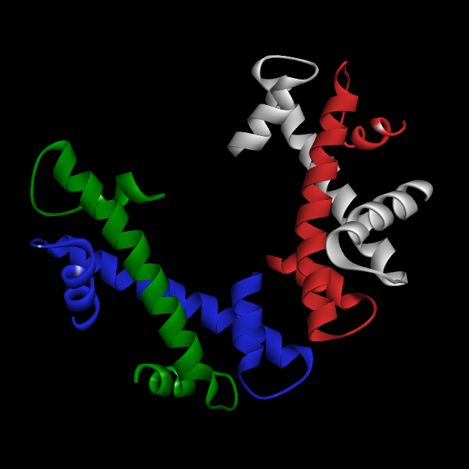
H3
H4
H2A
H2B
Table of Contents
Notes:
<H3[e]-H4[f]-H2A[g]-H2B[h].png> Histones are composed of 4 subunits: H3, etc. “Now, to distinguish these 4 subunits from the other 4, we add lower-case letters” (said just before transition to next slide).

Slide 34
“LOGICAL TETRAMER”
H3[a]
H4[b]
H2A[c]
H2B[d]
Table of Contents
Notes:
<H3[e]-H4[f]-H2A[g]-H2B[h].png>. “Now, to distinguish these 4 subunits from the other 4, we add lower-case letters” (this is said on previous slide). By the way, that “V” structure, now quasi-upright, is seen again here. We’ll be discussing it in more detail shortly.
NOTE: AUDIO FILE NAMED "Slide 34 [was 32-a].mp3"

Slide 35
H3[a]
H4[b]
H2A[c]
H2B[d]
Table of Contents
Notes:
<H3[e]-H4[f]-H2A[g]-H2B[h].png>. “Now, to distinguish these 4 subunits from the other 4, we add lower-case letters” (this is said on previous slide). By the way, that “V” structure, now quasi-upright, is seen again here. We’ll be discussing it in more detail shortly.
NOTE: AUDIO FILE NAMED "Slide 35 [was 32-b].mp3"

Slide 36
Table of Contents
Notes:
<Octamer_truncated.png>. Now we’re looking at the core of the octamer. Say: Something about the tetramer basis of the structure, and about how we’re going to look at that. But first, note the “inverted V” shape, which I also think of sometimes as a pyramid: We’re going to be seeing that again.

Slide 37
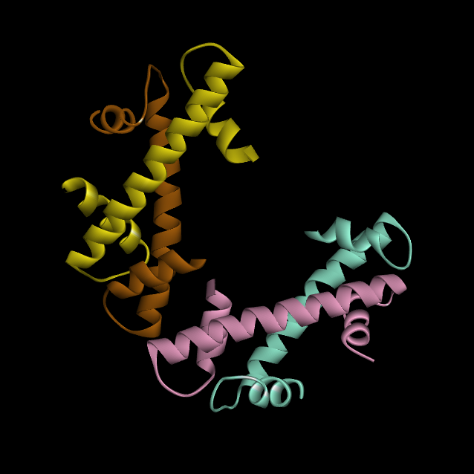
H3
H4
H2B
H2A
Table of Contents
Notes:
<H3[e]-H4[f]-H2A[g]-H2B[h].png>

Slide 38
H3[e]
H4[f]
H2B[h]
H2A[g]
Table of Contents
Notes:
<H3[e]-H4[f]-H2A[g]-H2B[h].png>

Slide 39
H3[e]
H3[a]
H4[b]
H4[b]
H2A[c]
H2B[d]
H2B[h]
H2A[g]
Table of Contents
Notes:
<Octamer_truncated.png>. Here’s the entire octamer core, all 8 subunits with labels. Before we examine the geometry of the octamer, let’s take a look at its constituent monomers.

Slide 40
Structure of the histone monomer The “histone fold”
Table of Contents

Slide 41
H3[e]
H3[a]
H4[b]
H4[b]
H2A[c]
H2B[d]
H2B[h]
H2A[g]
Table of Contents
Notes:
<Octamer_truncated.png>. Here’s the octamer core again. Let’s remove everything except a single monomer; in this case one of the H3’s:

Slide 42
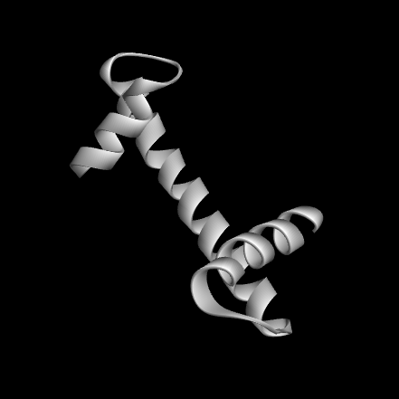
H3[a]
“Histone Fold”
Table of Contents
Notes:
<H3[a]_truncated-0.png> This slide preserves the position of H3[a] in the octamer, so it’s clear to the audience exactly where this subunit came from. Mention: “Histone fold” = “a long central helix flanked on either side by a loop and a short helix” (Ramakrishnan).

Slide 43
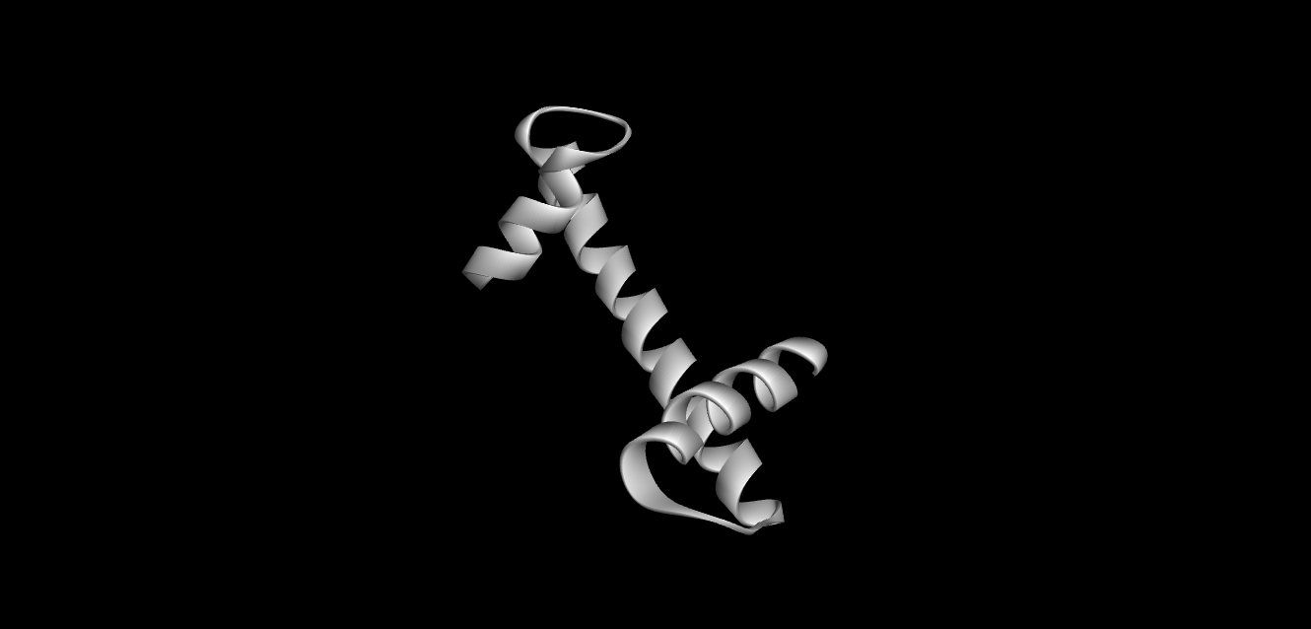
Table of Contents
Notes:
<H3[a]_truncated1.png>. Say: “This is not entire H3[a]...only core w ‘histone fold’ (long central α-helix, attached on each end to a loop and a shorter helix)...common to all 8 histone octamers...each one has unique additional N-terminal and C-terminal elements which are not common to the others...in H3, there is an additional helix at the N-terminal end:”

Slide 44
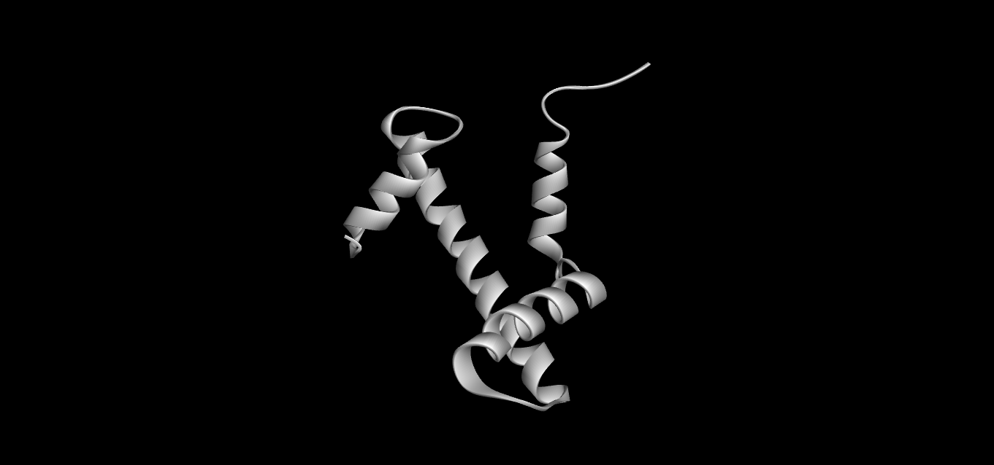
Additional helix
Table of Contents
Notes:
<H3[a]_complete.png>. But this additional helix is not found in the other octamer subunits, so, for the time being at least, we are going to remove it.

Slide 45
C-terminus
N-terminus
Helix I
Table of Contents
Notes:
<H3[a]_truncated1.png>. This slide transitions to a central position, then presents the “anatomy” of the individual histone subunit. Ramakrishnan calls this truncated core the “histone fold”. The conformation is “HSH”, and the structure of the strands is like that of the strands of a β-sheet, only less orderly, wherefore we refer to them as “β-Strand 1-2”.
REVISED SLIDE ONLY GOES UP TO “HELIX I”. HELIX II, ETC, CONTINUES ON NEXT SLIDE.

Slide 46
Helix III
C-terminus
Helix II
Helix I
Table of Contents
Notes:
<H3[a]_truncated1.png>. This slide transitions to a central position, then presents the “anatomy” of the individual histone subunit. Ramakrishnan calls this truncated core the “histone fold”. The conformation is “HSH”, and the structure of the strands is like that of the strands of a β-sheet, only less orderly, wherefore we refer to them as “β-Strand 1-2”.
REVISED SLIDE STARTS AT HELIX II.

Slide 47
Table of Contents
“HSH”
β-Strand 2
Helix III
Helix II
Helix I
β-Strand 1
“HSH”
Ramakrishnan V. Histone structure and the organization of the nucleosome. Ann Rev Biophys Biomol Struct (1997). 26:83-112. PMID: 9241414.
Notes:
<H3[a]_truncated1.png>. This slide transitions to a central position, then presents the “anatomy” of the individual histone subunit. Ramakrishnan calls this truncated core the “histone fold”. The conformation is “HSH”, and the structure of the strands is like that of the strands of a β-sheet, only less orderly, wherefore we refer to them as “β-Strand 1-2”.
REVISED SLIDE STARTS AT β-STRANDS 1 & 2.

Slide 48
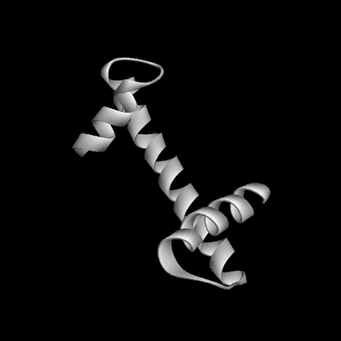
Table of Contents
Notes:
<H3[a]_truncated-rotate3.avi>. Movie showing the features of H3[a]. NO LOOP! TURNED INTO FOUR IDENTICAL, 1-REVOLUTION SLIDES, SO THAT THERE’S A CERTAINTY THAT THE SLIDE AFTER THE 4TH SLIDE (NOW #’D 52) WILL BE IN SYNCH WITH THE END OF THE 4TH ROTATION.
THIS IS SLIDE 1, CONTAINING THE AUDIO.

Slide 49
Table of Contents
Notes:
<H3[a]_truncated-rotate3.avi>. Movie showing the features of H3[a]. NO LOOP! TURNED INTO FOUR IDENTICAL, 1-REVOLUTION SLIDES, SO THAT THERE’S A CERTAINTY THAT THE SLIDE AFTER THE 4TH SLIDE (NOW #’D 52) WILL BE IN SYNCH WITH THE END OF THE 4TH ROTATION.
THIS IS SLIDE 2

Slide 50
Table of Contents
Notes:
<H3[a]_truncated-rotate3.avi>. Movie showing the features of H3[a]. NO LOOP! TURNED INTO FOUR IDENTICAL, 1-REVOLUTION SLIDES, SO THAT THERE’S A CERTAINTY THAT THE SLIDE AFTER THE 4TH SLIDE (NOW #’D 52) WILL BE IN SYNCH WITH THE END OF THE 4TH ROTATION.
THIS IS SLIDE 3

Slide 51
Table of Contents
Notes:
<H3[a]_truncated-rotate3.avi>. Movie showing the features of H3[a]. NO LOOP! TURNED INTO FOUR IDENTICAL, 1-REVOLUTION SLIDES, SO THAT THERE’S A CERTAINTY THAT THE SLIDE AFTER THE 4TH SLIDE (NOW #’D 52) WILL BE IN SYNCH WITH THE END OF THE 4TH ROTATION.
THIS IS SLIDE 4

Slide 52

Table of Contents
Notes:
<H3[a]_truncated1.png> again. This is the last frame of the above movie. Use this pause to discuss the 2-fold axis, which is illustrated by use of the PowerPoint rotate-function in the next slide.

Slide 53
Table of Contents
Notes:
<H3[a]_truncated1.png>, yet again. Rotated via PowerPoint rotate-function. This is to illustrate the 2-fold axis.

Slide 54
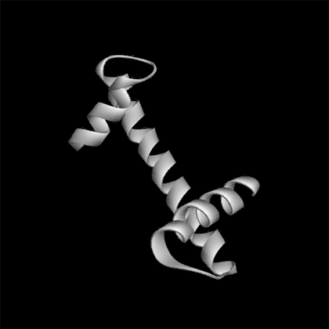
Table of Contents
Notes:
<H3[a]_erect.avi> (NO AUDIO) (3.5 seconds)

Slide 55
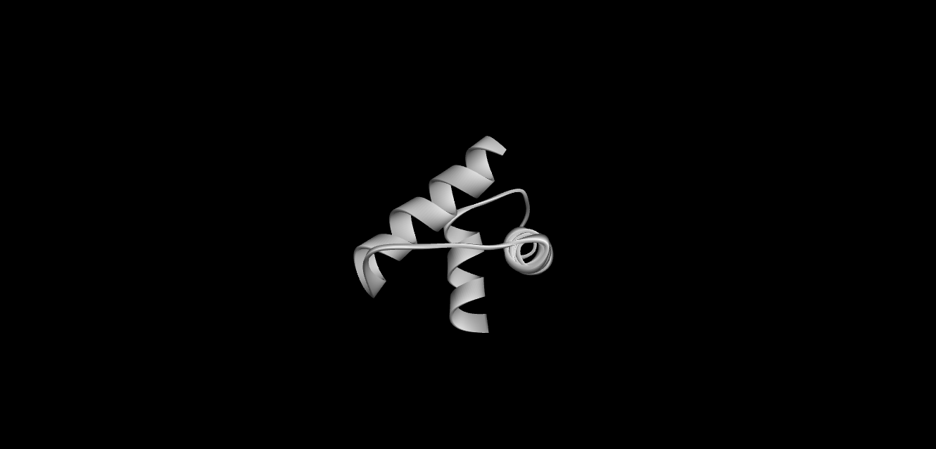
Helix I
Helix II
Helix III
Table of Contents
Notes:
<H3_erect28.png>. This is the last frame of the movie. On the next slide, the Helix I – Helix III angle will be presented. For what it’s worth.

Slide 56
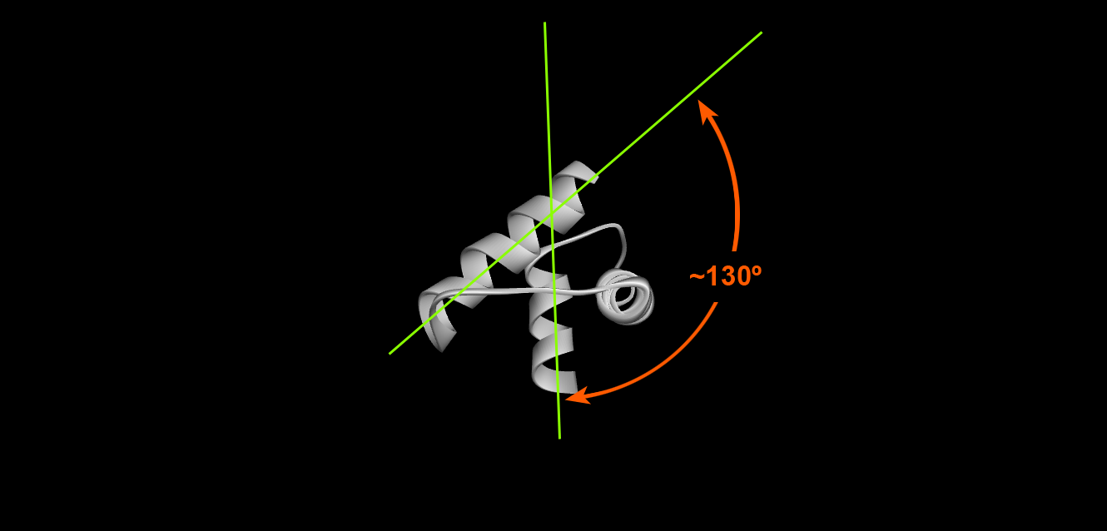
Table of Contents
Notes:
<H3[a]_erect_annotated.png>. This somewhat pointless slide shows the ~130º angle between Helix I and Helix III in H3[a].

Slide 57
Other α-helices (in addition to Helices I, II and III)
Table of Contents

Slide 58

Helix III
Helix “0”
Helix II
Helix I
Table of Contents
Notes:
<H3[a]-only_Luger.png>. Say “in add’n to our ‘old friends’ Helices I-III, we see that H3 also has Helix “0”.

Slide 59
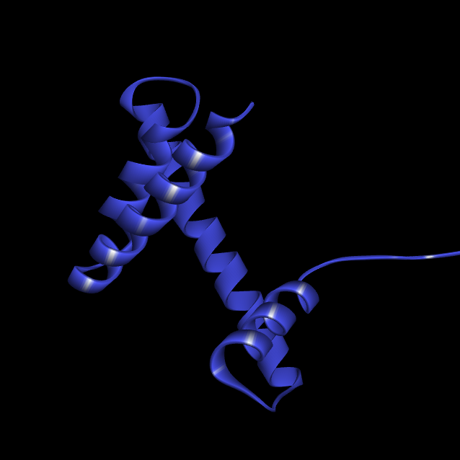
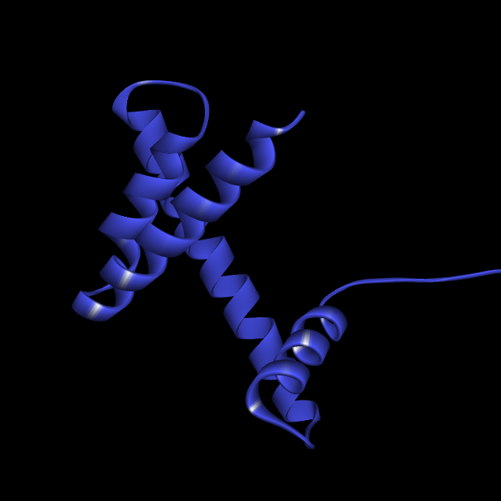
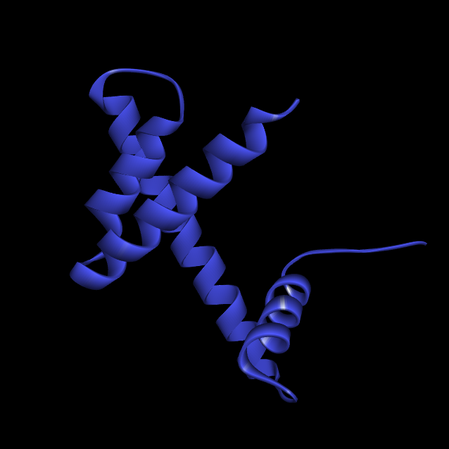
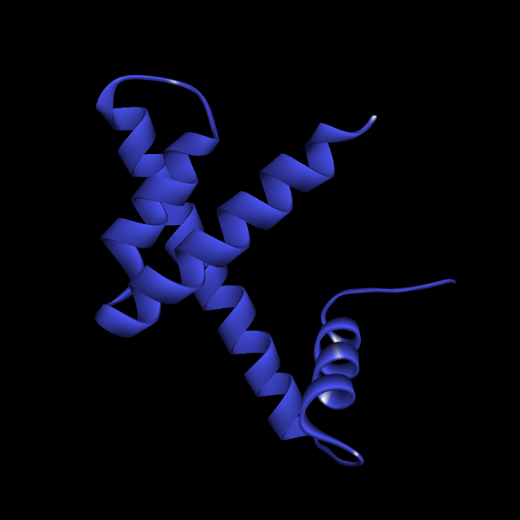
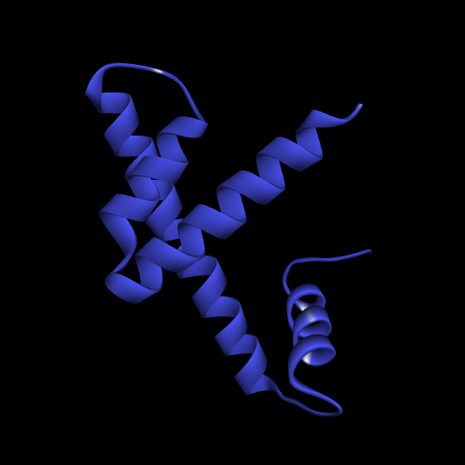
“Helix IV”
Helix III
Helix II
Helix I
Table of Contents

Slide 60
Dimers
Table of Contents

Slide 61
H3[a]
H4[b]
Table of Contents
Notes:
<Octamer_truncated.png>. Let’s return to our truncated octamer, and take a look at how the subunits interact with each other.

Slide 62
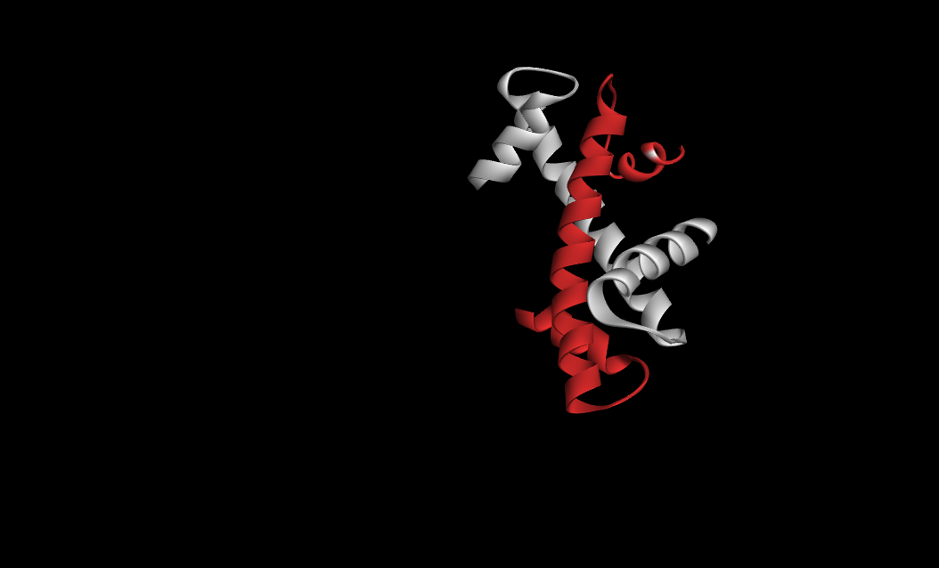
H3[a]
H4[b]
Table of Contents
Notes:
<H3[a]-H4[b]_0.png>. For our dimer study, let us choose H3-H4. First, let’s center it.

Slide 63
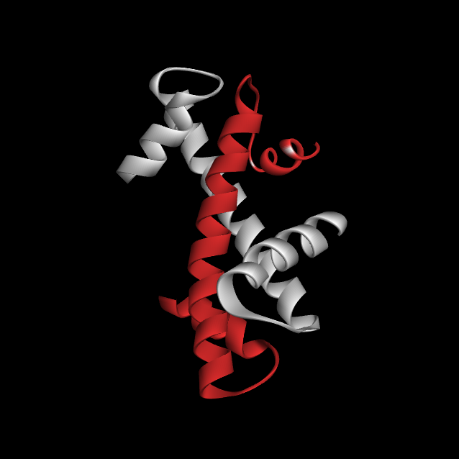
N
C
N
C
Table of Contents
Notes:
<H3-H4_rotate_0.png> (Centered dimer). Discuss N- and C-termini, esp. wrt the soon-to-be-critical N-terminal spacing. Discuss the approx. anti-parallel orientation of Helix II. DISCUSS ITS HYDROPHOBIC NATURE (refer to the notes currently labeled “Slide 104”; Helix II averages only 9% basic, but 57% hydrophobic). Introduce movie on next slide.

Slide 64
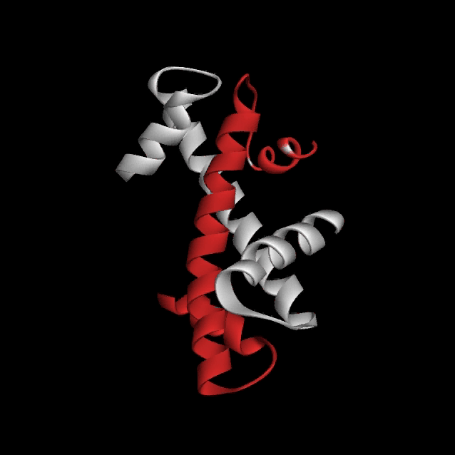
Table of Contents
Notes:
<H3-H4-rotate.avi> (PP says this video is 7 sec, but it’s really 7.4 sec. Within the framework of the 46 minute audio, there’s time for 6 rotations = 44.4 seconds).

Slide 65
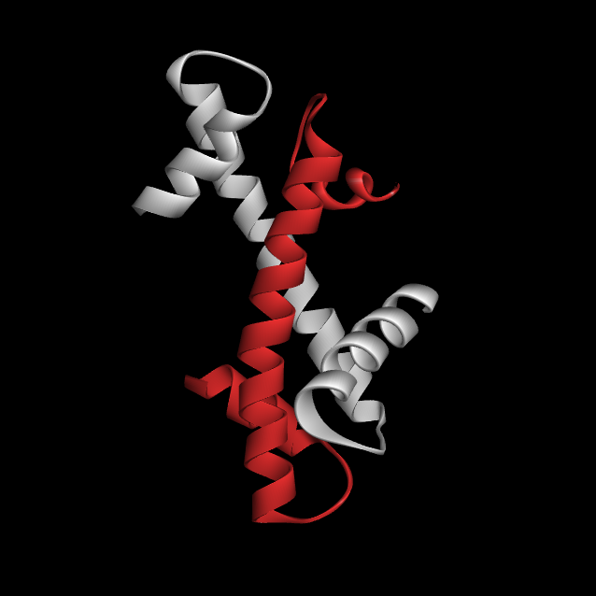
Table of Contents
Notes:
<H3-H4_2-fold_0.png>. To show approximate 2-fold axis (comment on homodimer). Say: “Slightly different view”, etc. Show the approx axis. “Look at H3, the white-colored monomer. Note that it’s long helix, Helix II, is underneath, and that its short helices are on top, pointing slightly downward. Now let us rotate the structure:

Slide 66

Table of Contents
Notes:
<H3-H4_2-fold_forward.avi> (Say, after the movie) “Now the long helix of H4, the red monomer, is on the bottom, with its short helices on top, pointing slightly down”.

Slide 67
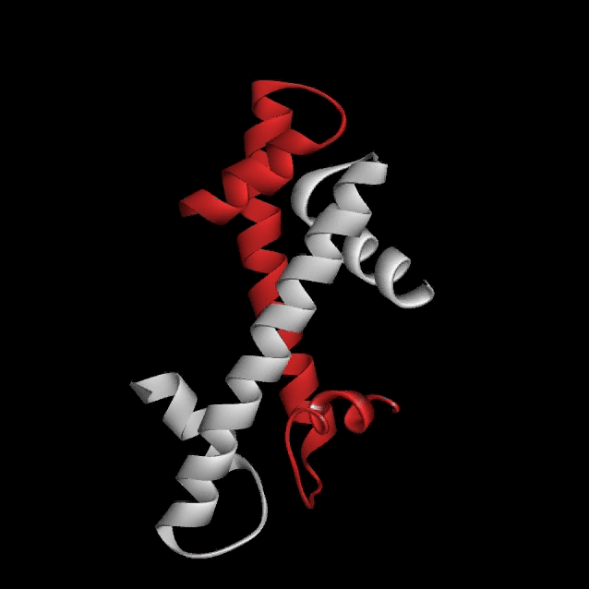
Table of Contents
Notes:
<H3-H4_2-fold_reverse.avi>. NEXT: WHAT HOLDS THIS THING TOGETHER?

Slide 68
Geometry of the [H3-H4]₂ tetramer
Table of Contents

Slide 69
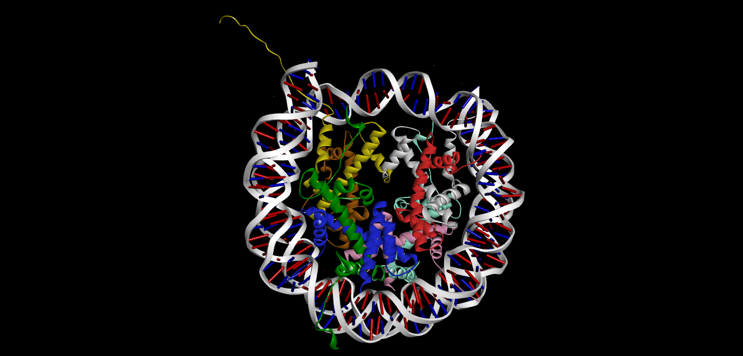
Table of Contents
Notes:
<1AOI-ribbons-DNA.png>. Say: We’re going to ret’n, etc etc., to show “classic” DNA-scarf structure.

Slide 70
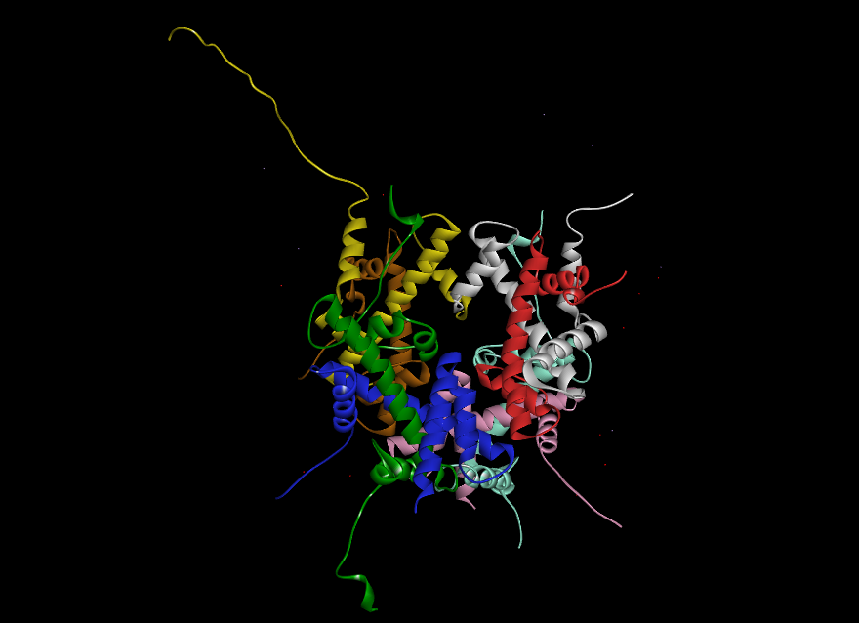
Table of Contents
Notes:
<1AOI-ribbons-no-DNA.png> Say: “Let’s once again remove the DNA. Note again the wild and unruly state of the N- and C-terminal strands. The orderliness of the structure is only seen in its core.”

Slide 71
Table of Contents
Notes:
<Octamer_truncated.png>. Let us, once again, remove the unruly N- and C-termini, and the extraneous helices, and concentrate on the core.

Slide 72
Table of Contents
Notes:
<Octamer_truncated.png>. Let’s center our truncated octamer.

Slide 73
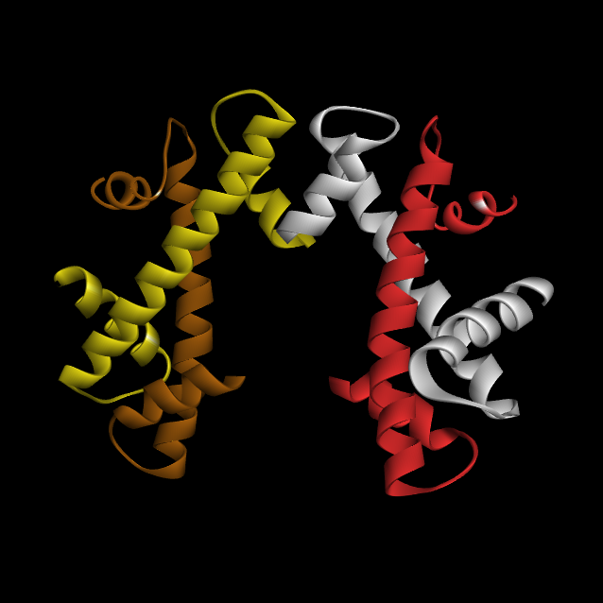
Table of Contents
Notes:
<H3[a]-H4[b]-H3[e]-H4[f]-centered.png>. Let’s remove everything but the H3-H4 dimers...

Slide 74
H3[e]
H3[a]
H4[b]
H4[b]
Table of Contents
Notes:
<H3[a]-H4[b]-H3[e]-H4[f]-centered.png>...and center them. (Labels). We’re looking now only at the pair of H3-H4 dimers which constitute the heart of the histone octamer. Why “heart”? BEFORE THAT, LET’S LOOK AT 2-FOLD AXIS.

Slide 75

Table of Contents
Notes:
<[H3]2-[H4]2-rotate.avi>

Slide 76
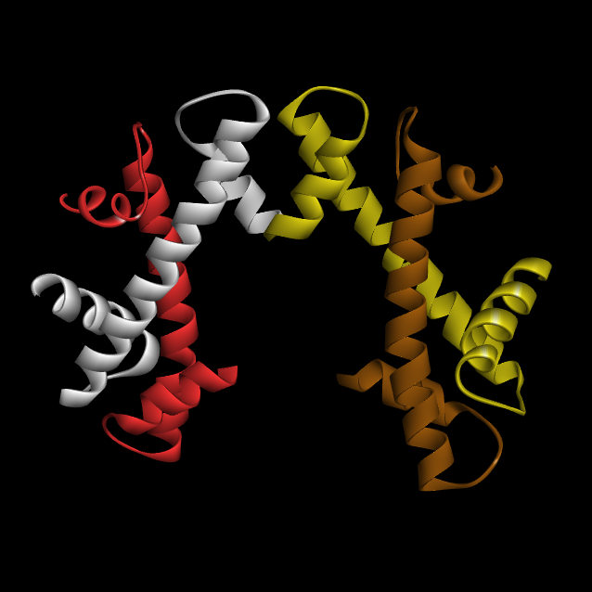
Table of Contents

Slide 77
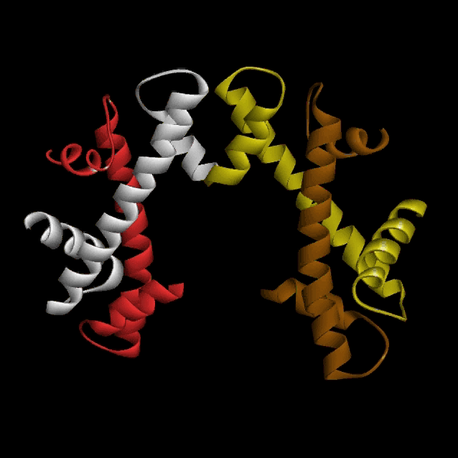
Table of Contents
Notes:
<[H3]2-[H4]2-reverse.avi> Let’s reverse it.

Slide 78
H3[e]
H3[a]
H4[b]
H4[b]
Table of Contents
Notes:
<H3[a]-H4[b]-H3[e]-H4[f]-centered.png> (again). NOW, before proceeding, lets look at the tetramer layers (from which you can “memorize the octamer structure”):

Slide 79

Table of Contents
Notes:
<H3-H4-rotate-to-parallel.avi>

Slide 80
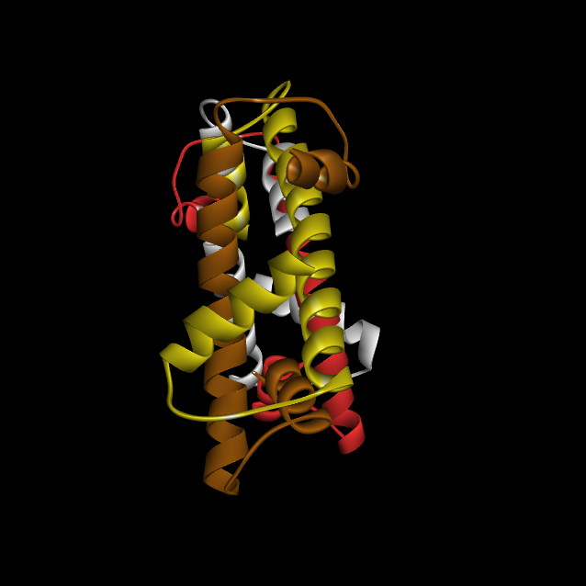
H3[a] Helix III
H3[e] Helix III
H3[e] Helix II
H3[a] Helix II
H4[b] Helix II
H4[f] Helix II
H4[f] Helix III
H4[b] Helix III
Table of Contents
Notes:
<[H3]2-[H4]2-PARALLEL.png>. Shows bi- or perhaps tri-laminar structure. The 1st layer, or lamina, consists mainly of the long Helix II’s of H3[e] and H4[b]. It also includes Helix III of H3[a], which, in this view, is barely visible, but which lies at the apex of the H3-H3 pyramid in the frontal view. The 2nd layer (describe)... There’s a small 3rd layer, consisting only of Helices III of H3[f] and H4[b], lying between the other two layers. It’s seen better if we rotate a bit...

Slide 81
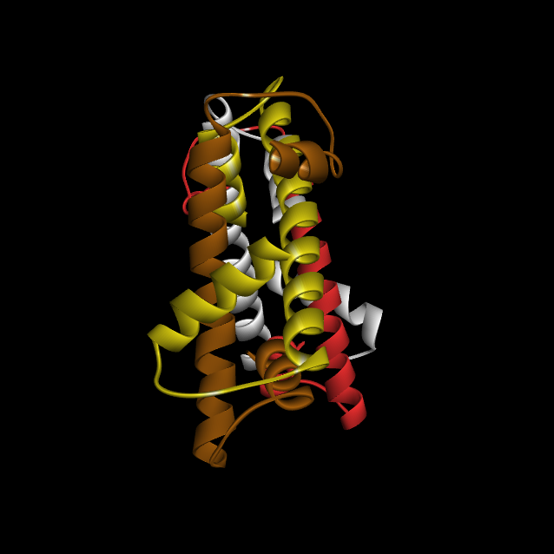
H4[f] Helix III
H4[b] Helix III
Table of Contents
Notes:
<[H3]2-[H4]2-PARALLEL2.png> There. Now their alignment is seen (although the other layers are now out of alignment; the histone octamer symmetries are all approximate). Although I can’t show it to you in this angle (because it would clutter the picture to the point of being incomprehensible), this 3rd layer is part of the bi-laminar structure of both of the other 2 corners of the histone octamer...

Slide 82
Table of Contents
Notes:
<[H3]2-[H4]2-PARALLEL.png>. I’m going to temporarily re-introduce the other 4 subunits of the histone octamer...

Slide 83
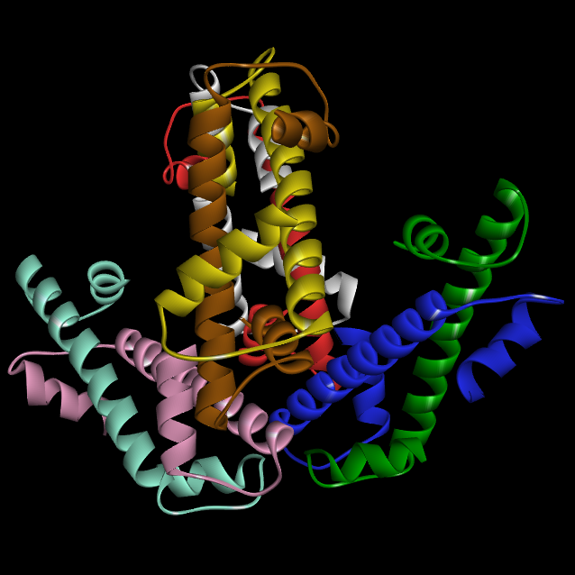
Table of Contents
H2A[c]
H2A[g]
H2B[d]
H2B[h]
Notes:
<Octamer_side-temp.png> ... It’s quite impossible to appreciate from this angle, but the subunits to the right and left are each part of a tri-laminar structure very similar to that in the middle. This will be easier to see in the frontal view, which we shall return to presently.

Slide 84
H4[b] Helix I
H4[f] Helix I
H3[a] Helix I
H3[e] Helix I
Table of Contents
Notes:
<[H3]2-[H4]2-PARALLEL.png>. OK – let’s remove the extraneous subunits again, because there’s one more thing I want to show you before we leave this view. I’ve been showing parallelisms; they all involve Helix II and Helix III. There are four helices, however, which are not at all involved: all 4 Helices I. Remember, attached to N-termini: presumably DNA-binding, and not core-structural.

Slide 85

Table of Contents
Notes:
<H3-H4-rotate-from-parallel.avi> OK, let’s unwind this view, and return to our frontal view of the H3-H4 tetramer.

Slide 86
What holds the octamer together? 1. H3-H3 interactions
Table of Contents

Slide 87
H3[e]
H3[a]
H4[b]
H4[b]
Table of Contents
Notes:
<H3[a]-H4[b]-H3[e]-H4[f]-centered.png> (again). (Beginning of discussion of H3-H4 hydrophobic/ionic bonds)

Slide 88
Homotypic Pairwise Interactions
Histone Aggregates observed
H1 Dimer (weak)
H5 None
H2A Dimer, tetramer and some larger aggregate
H2B Dimer, tetramer (weak)
H3 High molecular weight aggregates
H4 High molecular weight aggregates
Heterotypic Pairwise Interactions
ΔGº ΔGº
Reaction kcal/mol product kcal/mol histone
2H3 + 2H4  (H3H4)₂ -28.1 -7.0
2 (H3H4)  (H3H4)₂ -7.2 -1.8
H2B + H2A  (H2BH2A) -8.1 -4.0
H2B + H4  (H2BH4) -8.1 -4.0
H2A + H3  (H2AH3) -6.7→-8.1 -3.4→-4.0
H2A + H4  (H2AH4) -6.2 -3.1
H2B + H3  (H2BH3) “Weak” —
Adapted from: Chromatin. K.E. van Holde. Springer-Verlag, 1989, pp. 163-164.
Primary references:
1. Roark, D.E., Geoghegan, T.E. & Keller, G.H. (1974) Biochem. Biophys. Res. Comm. 59:542-547.
2. D'Anna, J.A. & Isenberg, I. (1974) Biochemistry 13:4992-4997.
3. Roark, E.E., Goeghegan, T.E., Keller, G.H., Matter, K.V. & Engle, R.C. (1976) Biochemistry 15:3019-3025.
Notes:
Say: “The important point is (blue arrow) the great propensity of H3 and H4 to form a tetramer, which was a key observation leading to the current concept of histone structure.”

Slide 89
Birth of the current nucleosome model
In 1973, Roger Kornberg was a postdoctoral researcher at the Cambridge MRC lab of Francis Crick. During the summer of that year, when everyone else was on vacation, Kornberg, in his own words,
"...pursued the notion of an H3-H4 complex by molecular weight determination in the analytical ultracentrifuge and, at Jean Thomas's suggestion (and with her help) by chemical crosslinking. The results were unequivocal, pointing to an (H3)₂(H4)₂ tetramer, and I drew the obvious conclusions: The stoichiometries of H2A, H2B, and DNA corresponded to a set of two each of all four histones and 200 base pairs of DNA: the globular nature of the H3-H4 tetramer called for wrapping the DNA around a histone core."
There was, however, an issue concerning the number of base pairs in the nucleosome. Australian researchers D. Hewish & L. Burgoyne had done gel electrophoresis analysis of nuclease digestion products of DNA, and Kornberg understood their result to point toward 500 bp's of DNA per nucleosome, more than twice what he was proposing (Hewish, D.R. & Burgoyne, L.A., 1973, Biochem. Biophys. Res. Comm. 52:504-510).
Says Kornberg: "The moment of discovery came some days later, after turning the ideas over in mind, when I thought again of the digestion pattern of Hewish and Burgoyne. What if the unit length of DNA had been measured in a neutral rather than alkaline sucrose gradient and corresponded to 250 rather than 500 base pairs? And what if the result was a bit off, the true value being nearer 200 base pairs? The possible agreement with the value I had conjectured from the stoichiometry of the tetramer was electrifying. I remember it was about 6 o'clock on a weekday evening and I rushed to the library. Hewish and Burgoyne referred to a paper by Williamson (Williamson, R., 1970, J. Mol. Biol. 51:157-168) on a similar pattern of DNA fragments from the cytoplasm of necrotic liver cells. Williamson reported a sedimentation coefficient consistent with a unit size of about 200 base pairs. I was euphoric.“ (van Holde, ibid., pp. 23-24)
Notes:
This is a passage from a letter to van Holde, in which Roger Kornberg describes his excitement and euphoria upon deducing the histone octamer structure. (Skip to the next slide, which highlights the essential line.)

Slide 90
Birth of the current nucleosome model
In 1973, Roger Kornberg was a postdoctoral researcher at the Cambridge MRC lab of Francis Crick. During the summer of that year, when everyone else was on vacation, Kornberg, in his own words,
"...pursued the notion of an H3-H4 complex by molecular weight determination in the analytical ultracentrifuge and, at Jean Thomas's suggestion (and with her help) by chemical crosslinking. The results were unequivocal, pointing to an (H3)₂(H4)₂ tetramer, and I drew the obvious conclusions: The stoichiometries of H2A, H2B, and DNA corresponded to a set of two each of all four histones and 200 base pairs of DNA: the globular nature of the H3-H4 tetramer called for wrapping the DNA around a histone core."
There was, however, an issue concerning the number of base pairs in the nucleosome. Australian researchers D. Hewish & L. Burgoyne had done gel electrophoresis analysis of nuclease digestion products of DNA, and Kornberg understood their result to point toward 500 bp's of DNA per nucleosome, more than twice what he was proposing (Hewish, D.R. & Burgoyne, L.A., 1973, Biochem. Biophys. Res. Comm. 52:504-510).
Says Kornberg: "The moment of discovery came some days later, after turning the ideas over in mind, when I thought again of the digestion pattern of Hewish and Burgoyne. What if the unit length of DNA had been measured in a neutral rather than alkaline sucrose gradient and corresponded to 250 rather than 500 base pairs? And what if the result was a bit off, the true value being nearer 200 base pairs? The possible agreement with the value I had conjectured from the stoichiometry of the tetramer was electrifying. I remember it was about 6 o'clock on a weekday evening and I rushed to the library. Hewish and Burgoyne referred to a paper by Williamson (Williamson, R., 1970, J. Mol. Biol. 51:157-168) on a similar pattern of DNA fragments from the cytoplasm of necrotic liver cells. Williamson reported a sedimentation coefficient consistent with a unit size of about 200 base pairs. I was euphoric.“ (von Holde, ibid., pp. 23-24)
Birth of the current nucleosome model
In 1973, Roger Kornberg was a postdoctoral researcher at the Cambridge MRC lab of Francis Crick. During the summer of that year, when everyone else was on vacation, Kornberg, in his own words,
"...pursued the notion of an H3-H4 complex by molecular weight determination in the analytical ultracentrifuge and, at Jean Thomas's suggestion (and with her help) by chemical crosslinking. The results were unequivocal, pointing to an (H3)₂(H4)₂ tetramer, and I drew the obvious conclusions: The stoichiometries of H2A, H2B, and DNA corresponded to a set of two each of all four histones and 200 base pairs of DNA: the globular nature of the H3-H4 tetramer called for wrapping the DNA around a histone core."
There was, however, an issue concerning the number of base pairs in the nucleosome. Australian researchers D. Hewish & L. Burgoyne had done gel electrophoresis analysis of nuclease digestion products of DNA, and Kornberg understood their result to point toward 500 bp's of DNA per nucleosome, more than twice what he was proposing (Hewish, D.R. & Burgoyne, L.A., 1973, Biochem. Biophys. Res. Comm. 52:504-510).
Says Kornberg: "The moment of discovery came some days later, after turning the ideas over in mind, when I thought again of the digestion pattern of Hewish and Burgoyne. What if the unit length of DNA had been measured in a neutral rather than alkaline sucrose gradient and corresponded to 250 rather than 500 base pairs? And what if the result was a bit off, the true value being nearer 200 base pairs? The possible agreement with the value I had conjectured from the stoichiometry of the tetramer was electrifying. I remember it was about 6 o'clock on a weekday evening and I rushed to the library. Hewish and Burgoyne referred to a paper by Williamson (Williamson, R., 1970, J. Mol. Biol. 51:157-168) on a similar pattern of DNA fragments from the cytoplasm of necrotic liver cells. Williamson reported a sedimentation coefficient consistent with a unit size of about 200 base pairs. I was euphoric.“ (van Holde, ibid., pp. 23-24)
Notes:
This shows the essential line. Let’s now look into the tetramer-forming propensity of H3 and H4, and see if we can understand it.

Slide 91
H3[e]
H3[a]
H4[b]
H4[b]
Table of Contents
Notes:
<H3[a]-H4[b]-H3[e]-H4[f]-centered.png> (again). With this in mind, we’re now in a position to answer the opening question of this section: “What holds the octamer together?”. The answer is: Mainly hydrophobic interactions. First of all, there’s the ubiquitous presence of the Helix II hydrophobic interactions. But now, let’s look at Helix III-Helix III...

Slide 92
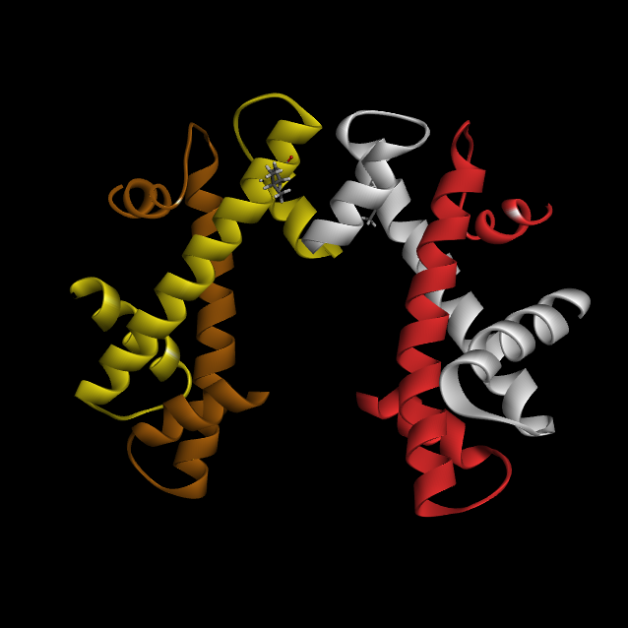
Table of Contents
H3[e]
H3[a]
Leucine 109
Notes:
<H3-H4-tetra_a_Leu109.png> First we have leucine 109, which, since these are both H3, will occur in both Helix III’s. The one in H3[a] is hidden around the back, and is indicated by an arrow. They’re too far apart, but wait...

Slide 93

Table of Contents
H3[e]
H3[a]
Leucine 126
Notes:
<H3-H4-tetra_a_Leu126.png> Next, we have leucine 126. These residues look hopelessly crushed together in this view, but wait...

Slide 94

Table of Contents
Isoleucine 130
Notes:
<H3-H4-tetra_a_Ile130png> Next, we have isoleucine 130. Neither of these are well-visualized from this angle. Let’s put them together and rotate the structure a bit:

Slide 95
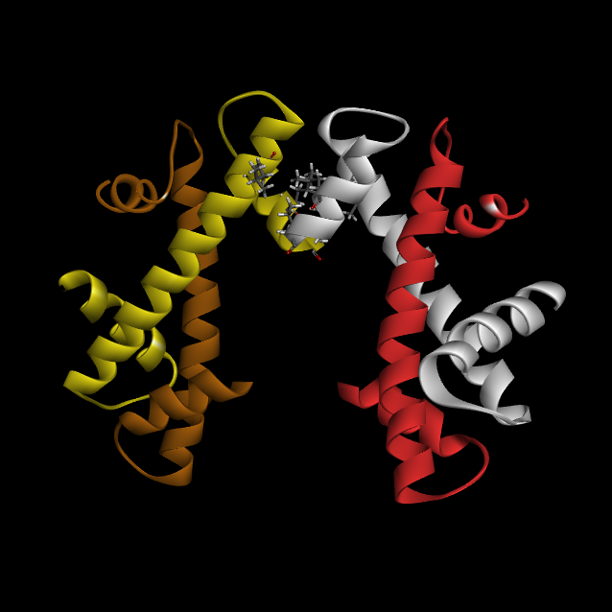
Table of Contents
Leu-109, Leu-126, Ile-130
Notes:
<H3-H4-tetra_L109-L126-I130_0.png> Here’s all 3 pairs of large hydrophobic residues (L109, L126, I130). Let’s rotate...

Slide 96
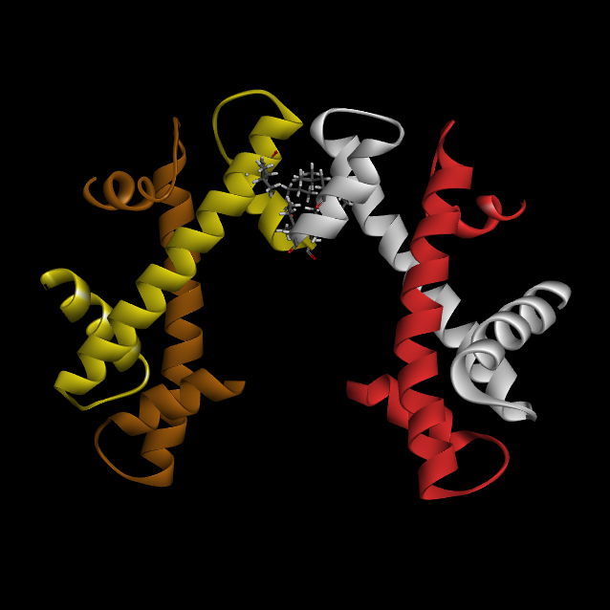
Table of Contents
Leu-109, Leu-126, Ile-130
Notes:
<H3-H4-tetra_L109-L126-I130_1.png>

Slide 97
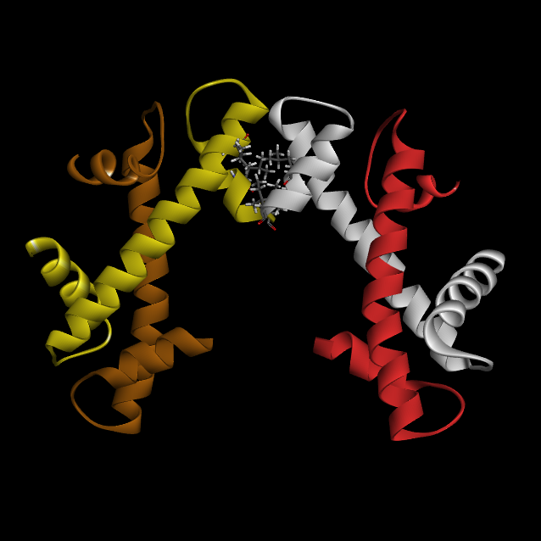
Table of Contents
Leu-109, Leu-126, Ile-130
Notes:
<H3-H4-tetra_L109-L126-I130_2.png>

Slide 98
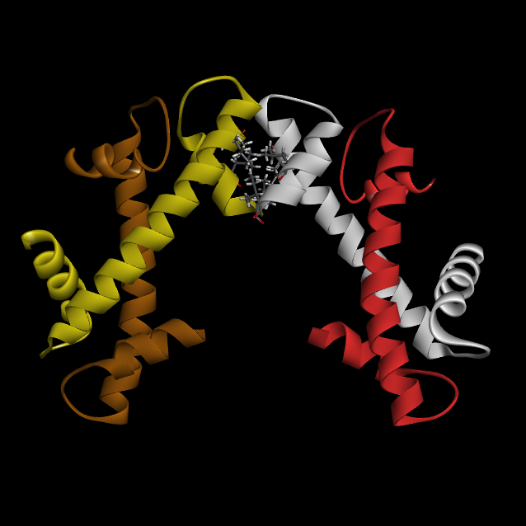
Table of Contents
Leu-109, Leu-126, Ile-130
Notes:
<H3-H4-tetra_L109-L126-I130_3.png>

Slide 99
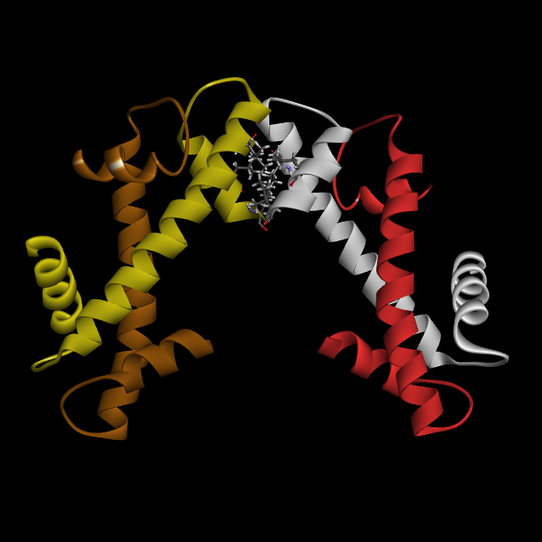
Table of Contents
Leu-109, Leu-126, Ile-130
Notes:
<H3-H4-tetra_L109-L126-I130_4.png>

Slide 100
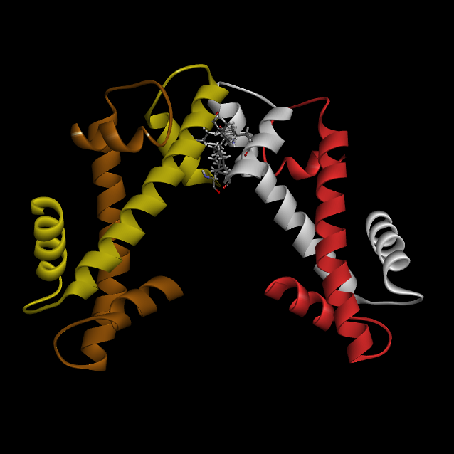
Table of Contents
Leu-109, Leu-126, Ile-130
Notes:
<H3-H4-tetra_L109-L126-I130_5.png>

Slide 101
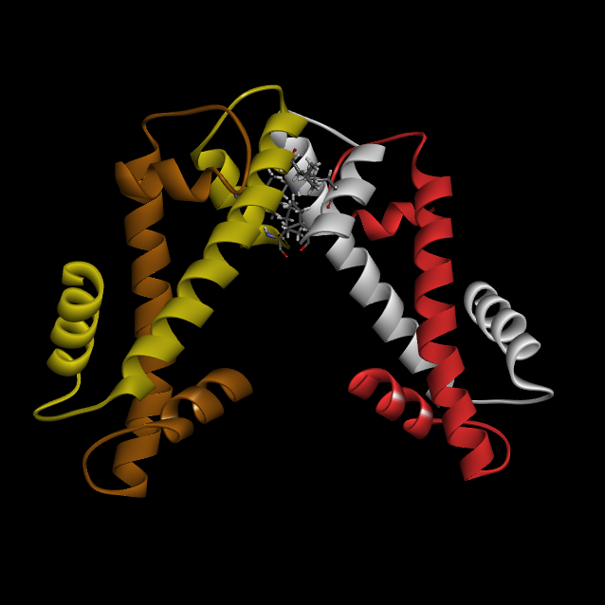
Table of Contents
Leu-109, Leu-126, Ile-130
Notes:
<H3-H4-tetra_L109-L126-I130_6.png>

Slide 102
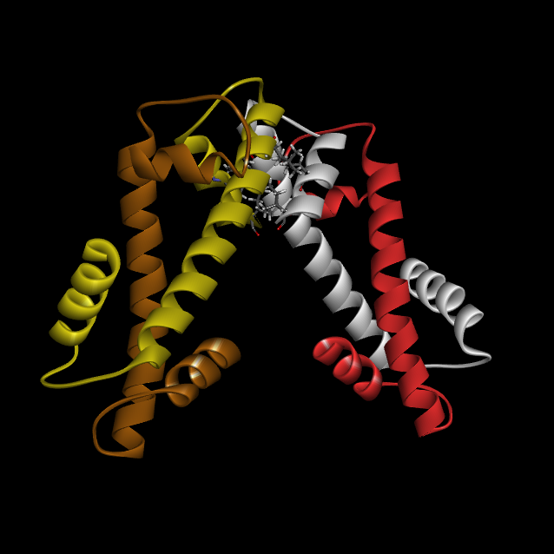
Table of Contents
Leu-109, Leu-126, Ile-130
Notes:
<H3-H4-tetra_L109-L126-I130_7.png> In this position, you can see that the large hydrophobic residues are actually not touching, but are spaced at about 4 angstroms. Let’s look at a closeup:

Slide 103
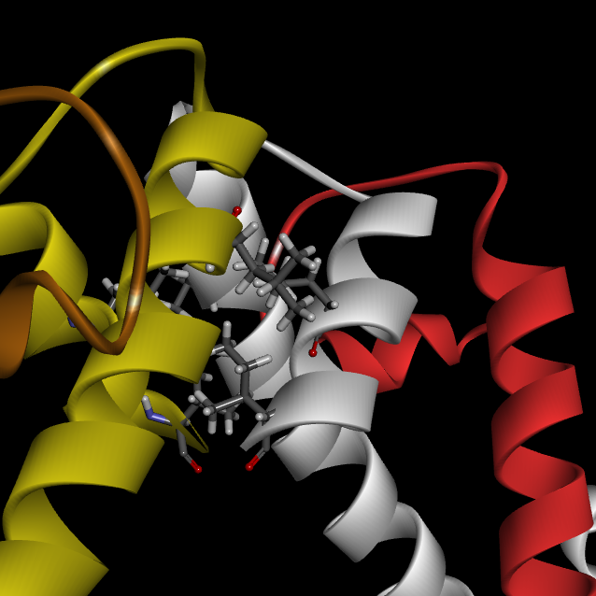
Table of Contents
Notes:
<H3-H4-tetra_L109-L126-I130_closeup.png> Closeup of H3-H4 Leu109, Leu126 and Ile130.

Slide 104
What holds the octamer together? 2. H3-H4 interactions
Table of Contents

Slide 105
H3[e]
H3[a]
H4[b]
H4[b]
Table of Contents
Notes:
<H3[a]-H4[b]-H3[e]-H4[f]-centered.png> OK; we’ve examined the hydrophobic mini-domain at the junction of H3[a] and H3[e]. Now let’s look at (H3-H4)(i.e., dimer interactions). Octamer=4 dimers. First of all: Helix II “X” shape – hydrophobic.

Slide 106
Average % amino acid composition
of monomer parts
Region Basic Hydrophobic Other ( = Hydrophylic+Acidic+Glycine)
N-terminus 34.4 26.8 38.8 ( = 19.7 + 2.8 + 16.3)
Helix II 9.0 55.7 35.3 ( = 17.1 + 14.6 + 3.6)
Average % amino acid composition
of monomer parts
Region Basic Hydrophobic Other ( = Hydrophylic+Acidic+Glycine)
N-terminus 34.4 26.8 38.8 ( = 19.7 + 2.8 + 16.3)
Helix II 9.0 55.7 35.3 ( = 17.1 + 14.6 + 3.6)
Table of Contents

Slide 107
Table of Contents
Notes:
<H3-H4_rotate_0.png> Let’s look at the Helix II-Helix II interactions. Here again is the H3[a]-H4[b] dimer. Let’s now isolate the Helix II’s.

Slide 108
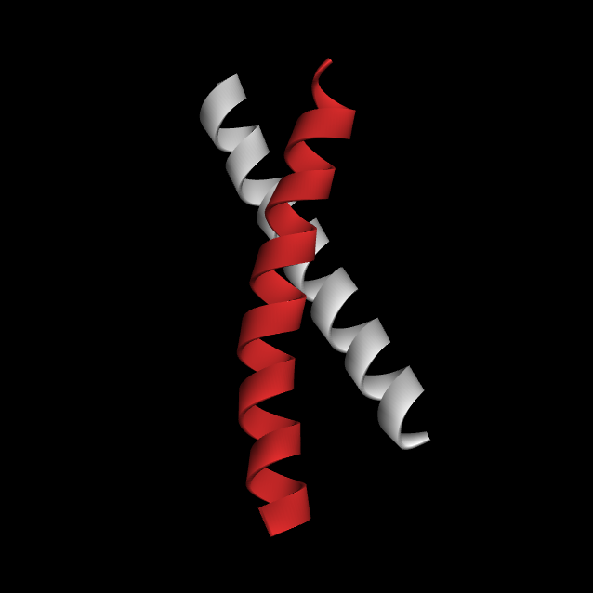
Table of Contents
Notes:
<Helix II_H3-H4-alley-TEMP.png> Now I’m going to selectively display the acidic, basic and large hydrophobic residues only. It’ll look a bit cluttered at first, but hang in there, because when we rotate it you’ll see the order.

Slide 109
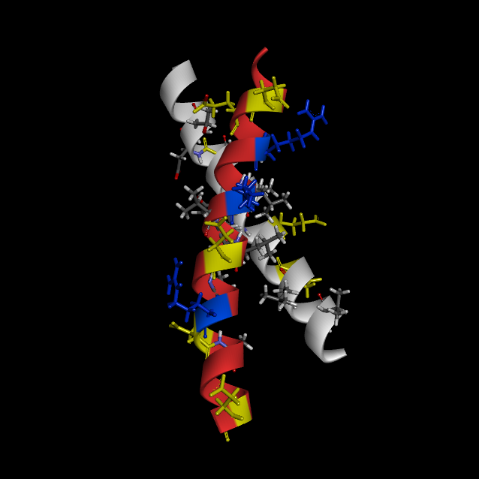
Table of Contents
Notes:
<Helix II_H3-H4-alley0.png> There we are. Now the acidic residues, namely Glu and Asp, are yellow, the basic residues, Arg/Lys, are blue. The large hydrophobic residues, Leu/Ile/Val/Phe, are displayed but not colored. Now let’s rotate: As the structure rotates, note the striking concentration of hydrophic residues in the alley between H3 and H4:

Slide 110
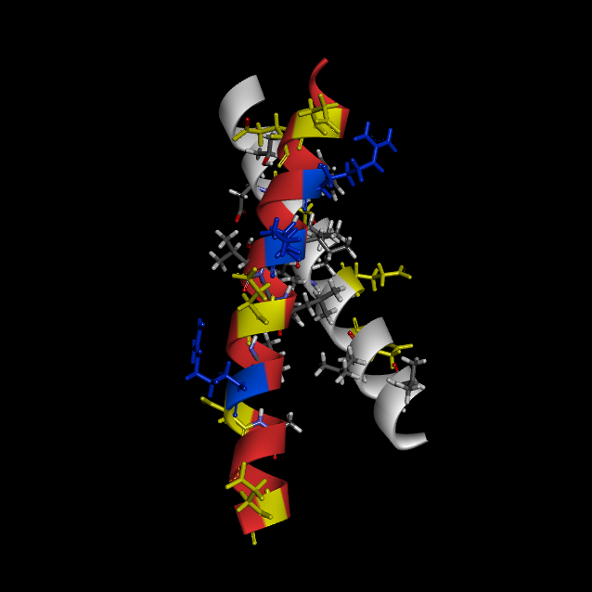
Table of Contents
Notes:
<Helix II_H3-H4-alley1.png>

Slide 111

Table of Contents
Notes:
<Helix II_H3-H4-alley2.png>

Slide 112

Table of Contents
Notes:
<Helix II_H3-H4-alley3.png>

Slide 113

Table of Contents
Notes:
<Helix II_H3-H4-alley4.png>

Slide 114

Table of Contents
Notes:
<Helix II_H3-H4-alley5.png>

Slide 115

Table of Contents
Notes:
<Helix II_H3-H4-alley6.png>

Slide 116

Table of Contents
Notes:
<Helix II_H3-H4-alley7.png>. In this view we see 2 things: (1) The alley between H3 and H4 is densely populated with Leu/Ile/Val/Phe residues, but entirely devoid of acidic or basic residues. Conversely, the periphery of the Helix II/Helix II structure contains all the acidic and basic residues. On the left, in H4, you may perhaps see that there are good salt bridges... Don’t forget: H2A-H2B Helices II have same structure.

Slide 117
β-Bridge 2
β-Bridge 2
Table of Contents
Notes:
<H3[a]-H4[b]-H3[e]-H4[f]-centered.png> (again). Let’s now look at the loop regions between the helices, starting at the top, (Explain terminology “β-Bridge 1-2“).

Slide 118

H3[e]
H3[a]
Leucine 109
Table of Contents
Notes:
<H3-H4-tetra_b_Ile-119.png>. Up here we find, on H3, Ile 119 and ...

Slide 119

Table of Contents
Notes:
<H3-H4-tetra_b_Ile-119_Ile46.png> ... on H4, Ile46.

Slide 120

β-Bridge 1
β-Bridge 1
Table of Contents
Notes:
<H3-H4-tetra_c[h3a]_D81-L82-F84_[h4b]_K79-V81_0.png>. Explain “β-Bridge 1”. Say “The interactions at the other end, BB1, are a bit more interesting, because they include not just hydrophobics but ionics”. Let’s rotate this a bit:

Slide 121

Table of Contents
Notes:
<H3-H4-tetra_c[h3a]_D81-L82-F84_[h4b]_K79-V81_1.png>

Slide 122

Table of Contents
Notes:
<H3-H4-tetra_c[h3a]_D81-L82-F84_[h4b]_K79-V81_2.png>

Slide 123

Table of Contents
Notes:
<H3-H4-tetra_c[h3a]_D81-L82-F84_[h4b]_K79-V81_3.png>

Slide 124

Table of Contents
Notes:
<H3-H4-tetra_c[h3a]_D81-L82-F84_[h4b]_K79-V81_4.png>

Slide 125

Table of Contents
Notes:
<H3-H4-tetra_c[h3a]_D81-L82-F84_[h4b]_K79-V81_5.png>

Slide 126

Table of Contents
Notes:
<H3-H4-tetra_c[h3a]_D81-L82-F84_[h4b]_K79-V81_6.png>

Slide 127

Table of Contents
Notes:
<H3-H4-tetra_c[h3a]_D81-L82-F84_[h4b]_K79-V81_7.png> Now we can see, on the left, the salt bridge between Asp81 of H3[a] and Lys79 of H4[b], and on the right the “hydrophobic bond” between Phe84 of H3 and Val81 of H4. Let’s take a closer look:

Slide 128

Table of Contents
Notes:
<H3-H4-tetra_c[h3a]_D81-L82-F84_[h4b]_K79-V81_CLOSEUP.png> In this view we can see the salt bridge, which is actually a bit close at 2.6 angstroms. Above, the benzyl side chain of Phe84 is seen, creating a mini-hydrophobic domain with the adjacent Val81.

Slide 129
Completion of the octamer Addition of H2A-H2B dimers
Table of Contents

Slide 130

Table of Contents
Notes:
<H2A-H2B-1.png> We start with the H3-H4 tetramer.

Slide 131

Table of Contents
Notes:
<H2A-H2B-2.png> Let’s dim the tetramer, and show where the H2A[c]-H2B[d] dimer will lie. Next: let’s ‘un-dim’ the tetramer.

Slide 132

Table of Contents
Notes:
<H2A-H2B-3.png>. We now have 6 of the 8 subunits incorporated into the histone octamer. Let’s look at the last dimer, H2A[g]-H2B[h]:

Slide 133

Table of Contents
Notes:
<H2A-H2B-4.png> Again we dim the 6 currently-incorporated subunits, and show the approximate location of the last H2A-H2B dimer. I say “approximate” because it’s depicted here as lying in front of the octamer, but it’s destined to lie in the back, like…

Slide 134

Table of Contents
Notes:
<H2A-H2B-5.png> This is all we’ll see of the H2A[g]-H2B[h] dimer in the completed octamer, in this view at least. Now we can un-dim everything:

Slide 135

Table of Contents
Notes:
<H2A-H2B-6.png> This gets us up to our 8-subunit structure.

Slide 136
Table of Contents
Notes:
<H2A-H2B-1.png> Now I’m going to review something I’ve shown you before, which illustrates a key aspect of octamer structure. If we return to the H3-H4 tetramer, we see this “inverted V”, or “pyramid” conformation, with two upright pillars bisecting the sloped sides of the pyramid on either side. Note that the upright pillar on the right is in front of the structure, and the one on the left is in the rear.

Slide 137
Table of Contents
Notes:
<H2A-H2B-6.png> (Momentary return to octamer)

Slide 138
H3[a]
H4[b]
H2A[c]
H2B[d]
Table of Contents
Notes:
<H3[e]-H4[f]-H2A[g]-H2B[h].png> Points to discuss: (1) The “inverted V” or upside-down pyramidal shape. (2) The fact that this is one of two instances of H2A-H2B-H3-H4 which comprise the octamer. Conceptually, this can be viewed as the tetramer-building-block of the octamer, although we know that the H3-H4 tetramer is more stable. Nevertheless, the interactions at the apex of the upside-down pyramid are quite similar to those seen in the H3-H4 tetramer, as shown in this closeup: SAY: “I’M GOING TO ROTATE THE CLOSE-UP VIEW SO THAT THE APEX OF THE PYRAMID IS POINTING UP, SO THAT THE GEOMETRY WILL BE COMPARABLE TO THE H3-H4 GEOMETRY WE ARE NOW FAMILIAR WITH.

Slide 139
H3[a]
H4[b]
H2A[c]
H2B[d]
Table of Contents
Notes:
DUPLICATE OF THE SLIDE ABOVE, reproduced for the purpose of rotating it to the upright position.

Slide 140

Table of Contents
Notes:
<H4[T71-Y72]-H2B[L80-T96-L100]-closeup.png> As with [H3-H4]2, we see a strongly hydrophobic pocket. H4, in red, contributes Thr71 and Tyr72. Although we don’t think of Thr as having a “bulky hydrophobic R group”, you will note that its methyl group is pointing advantageously into this hydrophobic realm. H2B, in blue, contributes Leu80, Thr96 and Leu100. Thr96 also places its methyl group quite strategically between the two Leu residues.

Slide 141
Table of Contents
Notes:
<H2A-H2B-6.png> OK, we’re back to the whole (although truncated) octamer. Let’s cut back to the H3-H4 tetramer again:

Slide 142
H3[a]
H4[b]
Table of Contents
Notes:
<H2A-H2B-1.png> Now I want to show you something interesting, at least I think it is. Look at the red and white H3[a]-H4[b] dimer in the pyramidal-shaped H3-H4 tetramer. Let’s now look at the new tetramer we created when we added H2A[c] and H2B[d]:

Slide 143
H3[a]
H4[b]
H2A[c]
H2B[d]
Table of Contents
Notes:
<H3[e]-H4[f]-H2A[g]-H2B[h].png> Do you see that the white and red subunits, H3[a] and H4[b], are involved in both tetramers? This is only important to note because, if you can keep it in mind (which is NOT easy for me; perhaps for you?), you’ll have the beginnings of a grasp on the 3D structure of the octamer. To complete your grasp of this particular view, you’ve got to understand that the green&blue H2A-H2B dimer is the anterior-most dimer in the octamer, wrt the z-axis, which is normal to the computer screen. We’ll see this more clearly when we look at the octamer from other angles.

Slide 144
H3[a]
H4[b]
Table of Contents
Notes:
<H2A-H2B-1.png> Let’s show that one more time: Here’s the H3-H4 tetramer...

Slide 145
H3[a]
H4[b]
H2A[c]
H2B[d]
Table of Contents
Notes:
<H3[e]-H4[f]-H2A[g]-H2B[h].png>

Slide 146
H3[e]
H4[f]
Table of Contents
Notes:
<H2A-H2B-1.png> OK, let’s go back to the H3-H4 tetramer yet again, this time paying attention to the left-hand H3-H4 dimer, namely the yellow & brown H3[e] and H4[f] subunits. Now let’s add the second H2A-H2B dimer:

Slide 147
H3[e]
H4[b]
Table of Contents
Notes:
<H3[e]-H4[f]-H2A[g]-H2B[h].png> Once again we see that H3-H4, this time the yellow&brown-colored subunits, is part of two tetramers. The difference here is that, although it’s not evident in this view, the turquise and pink H2A-H2B dimer is the rear-most dimer of the histone octamer, as we shall see shortly.

Slide 148
H3[e]
H4[b]
Table of Contents
Notes:
<H2A-H2B-1.png> OK, let’s go back to the H3-H4 tetramer yet again, this time paying attention to the left-hand H3-H4 dimer, namely the yellow & brown H3[e] and H4[f] subunits. Now let’s add the second H2A-H2B dimer:

Slide 149
H3[e]
H4[b]
H2A[g]
H2B[h]
Table of Contents
Notes:
<H3[e]-H4[f]-H2A[g]-H2B[h].png> Once again we see that H3-H4, this time the yellow&brown-colored subunits, is part of two tetramers. The difference here is that, although it’s not evident in this view, the turquise and pink H2A-H2B dimer is the rear-most dimer of the histone octamer, as we shall see shortly.

Slide 150
Table of Contents
Notes:
<Octamer_truncated.png>. In a few minutes we’ll turn the octamer around, so we can grasp its structure from perspectives other than the one we have been using almost exclusively up until now. But first, we’re going to strip it down to its barest essentials, so we can really get to know the hydrophobic core:

Slide 151
Helix II “backbone”
Table of Contents

Slide 152

Table of Contents
Notes:
<Helix II octamer.png> We’ve now stripped the octamer down to it’s barest essentials, namely the most central core structure, consisting of the 8 long α-helices known as Helix II. The single most critically-important sub-structure within it is the H3-H4 tetramer, believed to be the foundation about which the octamer forms:

Slide 153

Table of Contents
Notes:
<Helix II H3-H4 tetramer.png> Remember that the pyramidal structure comes about through hydrophobic interactions at the C-termini, indicated by the blue arrow.

Slide 154
Table of Contents
Notes:
<Helix II octamer.png> The two halves of the H3-H4 tetramer are each part of one of the two tetramers which define the histone octamer:

Slide 155

Table of Contents
Notes:
<Helix II H3[a]-H4[b]-H2A[c]-H2B[d].png> This is the first instance of the H3-H4-H2A-H2B tetramer. The structure is analogous to that of the H3-H4 tetramer, only rotated clockwise.

Slide 156
Table of Contents
Notes:
<Helix II octamer.png> The second instance of the H3-H4-H2A-H2B tetramer is sort of hiding in the back of the octamer:

Slide 157

Table of Contents
Notes:
<Helix II H3[e]-H4[f]-H2A[g]-H2B[h].png> This structure is also analogous to the H3-H4 tetramer, only rotated counter-clockwise.

Slide 158

150º
Table of Contents
Notes:
<Helix II rotate0.png> The first instance of H3-H4-H2A-H2B can be imagined conceptually as the structure which arises when the H3-H4 tetramer shape is rotated about 150º (the “V” shape, after rotating, has to be moved a bit, because these relationships are all approximate). This angle is quite approximate, but, in any event, one can see that this is hardly a “perfect” equilateral triangular arrangement, where the corners of the rotations would be a perfect 120º apart.

Slide 159
-145º
Table of Contents
Notes:
<Helix II rotate0.png> The second instance of H3-H4-H2A-H2B, which is now hidden in the rear again, can be thought of as that which arises by rotating the H3-H4 tetramer approximately 145º counterclockwise (and then pushing the “V” shape down quite a bit).

Slide 160
Can the octamer structure be logically extended, to create a dimer from two adjacent octamers?
That is, can adjacent octamers join via H2A-H2A hydrophobic bonds?
Table of Contents

Slide 161
Table of Contents
Notes:
<Helix II rotate0.png> Introductory slide for Helix II core rotation, on next slide. “Now we’re going to see that in addition to the imperfection of the angles of rotation bet’n the pyramids, there is also a large discrepancy in the planes in which they dwell. Let’s rotate this structure to see:”

Slide 162






Table of Contents
Notes:
<Helix II rotate0→6a.png> (The original slide “rotate6.png” was not quite the right degree of rotation).

Slide 163
(“Front”)
Table of Contents
Notes:
<Helix II rotate6a.png> (Final slide of previous “movie”). In this view, the structural elements we have been referring to as “pyramids” look more like track and field parallel bars! The central structural element of the histone octamer, the H3-H4 tetramer, is now in the middle, looking like 4 parallel upright posts. The purpose of this slide is to show where the other 2, formerly “pyramidal” structures are now. Remember that each of the H3-H4 dimers is involved simultaneously in two such structures. The red and yellow H3[a] and H4[b] are associated with the green and blue H2A[c] and H2B[d]:

Slide 164

*
*
(“Front”)
**
**
Table of Contents
Notes:
<Helix II rotate6a-FRONT.png> (Showing the H3[a]-H4[b]-H2A[c]-H2B[d] tetramer). Note that this tetramer extends to the “front” of the histone octamer, according to the positional convention we have been employing thus far. From that perspective, the green histone subunit, H2A[c], is the most anterior molecule of the histone octamer...

Slide 165
Table of Contents
Notes:
<Helix II rotate0→6a.png> ...whereas the H2A molecule of the second H3-H4-H2A-H2B tetramer is the extreme rear of the structure:

Slide 166

*
*
H2A[g]
(“Rear”)
**
**
Table of Contents
Notes:
<Helix II rotate6a-REAR.png> In a moment I’m going to show you how these positions can be construed to be advantageous wrt answering the question: “Is it possible that the pyramidal structures we have been looking at can give rise to a dimer of histone octamers?”

Slide 167
C-terminus
C-terminus
H2A[c]
H2A[g]
Table of Contents
Notes:
<Helix II rotate0→6a.png> Now, if you’re REALLY observant, you may perhaps have noticed something interesting: Each of the 6 central subunits in this view are associated with one or more of those pyramidal structures we’ve been looking at. HOWEVER...the extreme anterior subunit, H2A[c], and the posterior subunit, H2A[h], are not so involved. Their C-termini are therefore free to form “V”-shaped hydrophobic bonds with other subunits, but there are none available. This raises an intriguing question: Might there be biological settings in which H2A[c] from one histone octamer forms a pyramidal structure with H2A[h] from an adjacent octamer, linking them together by hydrophobic interactions at their C-termini? The result might, in an extremely preliminary manner, be depicted as follows:

Slide 168


Table of Contents
Notes:
<H2A-H2A_octamer1 & 2.png> Might adjacent octamers join thusly? Here are two adjacent octamers, suggestively depicted as having that inverted “V” relationship involving the C-termini of their H2A residues. But is this the right joining angle? The apices of these inverted “V”s have very particular requirements for interatomic distances and dihedral angles:

Slide 169
Frontal view
Side
view
Table of Contents
Notes:
(No picture file. From p. 127 of <000aaa-histone-1aoi.docx>). Let us construct…The proper orientation is that which matches the orientation of the three pyramidal structures in the octamer; namely the H3-H4 tetramer and the two H3-H4-H2A-H2B tetramers. In the frontal view, we need to see the now-characteristic “inverted V” shape. In the lateral view, we need to see a perfect or nearly perfect alignment of Helix III of each subunit with Helix II of the other. The structure shown here is purely hypothetical, since H2A[c] and H2A[g] are on opposite sides of the histone octamer, and this intimate joining can only take place between 2 adjacent octamers, something not currently know to occur.

Slide 170
Table of Contents
Notes:
<Helix II rotate0.png> REPEAT OF SLIDE 161. [Introductory slide for Helix II core rotation, on next slide. “Now we’re going to see that in addition to the imperfection of the angles of rotation bet’n the pyramids, there is also a large discrepancy in the planes in which they dwell. Let’s rotate this structure to see:”
]

Slide 171
Table of Contents
Notes:
<Helix II rotate0→6a.png> REPEAT OF SLIDE 162. [(The original slide “rotate6.png” was not quite the right degree of rotation).]

Slide 172

Table of Contents
Notes:
<H2A-H2B_NO-hydrophobic-bonds.png> Here’s a hypothetical pyramidal structure, containing both the inverted “V” and the two upright pillers, which must be seen if the external joining geometry between two octamers is the same as the analogous geometry seen within the octamers.

Slide 173







Table of Contents
Notes:
<H2A-H2A_dimer-of-octamers_rotate0-7.jpg> <Actually, “0” wasn’t used; that’s the previous slide>. Faux-movie, showing H2A-H2A INTER-octamer “bond”, rotated 90º.

Slide 174
Table of Contents
Notes:
<H2A-H2B_NO-hydrophobic-bonds.png> Here’s a hypothetical pyramidal structure, containing both the inverted “V” and the two upright pillers, which must be seen if the external joining geometry between two octamers is the same as the analogous geometry seen within the octamers.

Slide 175

Table of Contents
Notes:
<H2A-H2B_hydrophobic-bonds.png> Here are all the hydrophobic residues stabilizing this structure. Even though this structure is not known to exist, it seems clear enough that it is possible, in principle, for it to form. But where would the rest of the 2 octamers be? In order to see this clearly, I took two octamers and colored 7/8 of the residues of each one with a single bland color, preserving only the original green color of H2A[c] on the right, and H2A[h] on the left:

Slide 176
Homotypic Pairwise Interactions
Histone Aggregates observed
H1 Dimer (weak)
H5 None
H2A Dimer, tetramer and some larger aggregate
H2B Dimer, tetramer (weak)
H3 High molecular weight aggregates
H4 High molecular weight aggregates
Heterotypic Pairwise Interactions
ΔGº ΔGº
Reaction kcal/mol product kcal/mol histone
2H3 + 2H4  (H3H4)₂ -28.1 -7.0
2 (H3H4)  (H3H4)₂ -7.2 -1.8
H2B + H2A  (H2BH2A) -8.1 -4.0
H2B + H4  (H2BH4) -8.1 -4.0
H2A + H3  (H2AH3) -6.7→-8.1 -3.4→-4.0
H2A + H4  (H2AH4) -6.2 -3.1
H2B + H3  (H2BH3) “Weak” —
Adapted from: Chromatin. K.E. van Holde. Springer-Verlag, 1989, pp. 163-164.
Primary references:
1. Roark, D.E., Geoghegan, T.E. & Keller, G.H. (1974) Biochem. Biophys. Res. Comm. 59:542-547.
2. D'Anna, J.A. & Isenberg, I. (1974) Biochemistry 13:4992-4997.
3. Roark, E.E., Goeghegan, T.E., Keller, G.H., Matter, K.V. & Engle, R.C. (1976) Biochemistry 15:3019-3025.
Notes:
Say: “The important point is (blue arrow) the great propensity of H3 and H4 to form a tetramer, which was a key observation leading to the current concept of histone structure.”

Slide 177












Table of Contents
Notes:
<Both_Octamers_H2A-H2A_0→11.jpg> If this hypothetical joined structure is rotated 90º, which I cannot do in PowerPoint, you’d see that there is some overlap between the two octamers, but the amount of overlap is surprisingly small. All things considered, it’s startling that when the joining geometry for H2A[c]-H2A[h] is adjusted thusly, the two octamers align so well, which almost persuades me that such joining really is possible. I am not suggesting, however, that this is a structure for histones which will be found under “normal” DNA-binding conditions, since EM studies show a “string of pearls” sort of arrangement, with adjacent octamers being not contiguous at all, but separated by lengths of so-called “linker” DNA.

Slide 178
X-axis, y-axis and z-axis
rotation of histone octamer
(movies)
Table of Contents

Slide 179

Table of Contents
Notes:
<Octamer_x-rotated_0.jpg> (1st slide of the following x-axis rotation movie) Histone octamer from three perspectives...First two view are of general interest only, but the 3rd view is critical to our understanding of histone binding to DNA, both by “classical” theory and by our theory. Here’s what you see if you rotate it about the x-axis:

Slide 180

Table of Contents
Notes:
<Octamer_x-rotated.avi><L= 8 seconds> (Movie of octamer rotating about Schrodinger x-axis) (4 rotations)

Slide 181

Table of Contents
Notes:
<Octamer_y-rotated_0.jpg> (Last slide of x-rotation movie = 1st slide of the following y-axis rotation movie)

Slide 182

Table of Contents
Notes:
<Octamer_y-rotated.avi>

Slide 183

Table of Contents
Notes:
<000-start-x-rotation.jpg> First slide of 90º x-rotation to equatorial position, then y-rotation.

Slide 184

Table of Contents
Notes:
<000-x-rotation.avi> MOVIE, 90º x-rotation to equatorial position (to be followed by y-rotation).

Slide 185

Table of Contents
Notes:
<000-start-y-rotation.jpg> 1st slide of the y-axis rotation of the 90º-x-rotated octamer (which is the same as the last slide; see 2 slides down).

Slide 186

Table of Contents
Notes:
<000_x-then-y-rotation.avi> Movie length = approx. 7.4 seconds. YOU CAN USE THIS SLIDE TO TEACH HISTONE EQUATORIAL PLANE (H3[a]-H4[b]-H2A[c]-H2B[d] bottom, H3[e]-H4[f]-H2A[g]-H2B[h] top). Note also the “Superhelical Groove”! --- CURRENTLY SET FOR 4 REVOLUTIONS = 29.6 seconds (PERFECT LENGTH! But probably too short for this discussion).

Slide 187
Table of Contents
Notes:
<000-start-y-rotation.jpg> Last slide of the y-axis rotation of the 90º-x-rotated octamer (which is the same as the first slide; see 2 slides up).

Slide 188

Table of Contents
Notes:
<000-start-y-rotation-SPRING.jpg> The spiral is made of 4 rather rectilinearly angular turns, which define 4 domains of theoretical DNA binding. First there is the turquoise/pink H2A/H2B dimer at the top of the slide, then the yellow/brown H3/H4 dimer in the middle on the left, then the other H3/H4 dimer in white/red in the middle on the right, then the other H2A/H2B dimer in the lower left of the rear of the structure. We’ll study this path more closely in a while.

Slide 189
Table of Contents
Notes:
<000_x-then-y-rotation.avi> Movie length = approx. 7.4 seconds. REPEAT OF ROTATION; THIS TIME ONLY 2 TURNS; FOR PURPOSE THAT VIEWERS SHOULD TRY TO DISCERN THE SPIRAL PATH OF THE “SUPERHELICAL GROOVE”.

Slide 190
Table of Contents
Notes:
<000-start-y-rotation.jpg> Last slide of the y-axis rotation of the 90º-x-rotated octamer.

Slide 191
Superhelical Ramp
Table of Contents

Slide 192
Table of Contents
Notes:
<1AOI-ribbons-DNA.png>

Slide 193

Table of Contents
Notes:
<H2A-H2B_Octamer_truncated.jpg> (Couldn’t use previous “Octamer truncated.png” because it’s moved a bit). Say: “I’m going to show the super groove; but you won’t see the whole thing, only part of each dimer as they appear in succession. So I’m going to show you which part we shall be displaying, and why”. Say: “As usual, we start with the truncated octamer in ‘root position’ ”.

Slide 194

Table of Contents
Notes:
<H2A[g]-H2B[h]_small.jpg> Let’s remove everything but the turquoise and pink H2A-H2B dimer...

Slide 195

H2B[h]
H2A[g]
Table of Contents
Notes:
<H2A[g]-H2B[h]_large_centered.jpg> ...and let’s center it. Say “Before proceeding, let us review the ‘anatomy’ of the histone dimer”. (THIS SLIDE WAS DUPLICATED BELOW BECAUSE THE TEXT BOXES {HELIX I} WILL OVERLAP THE {H2?[n]}’s, WHICH WILL MAKE THE TIMINGS ANNOYINGLY DIFFICULT TO ADJUST.)

Slide 196
β-Strand 2
β-Strand 1
Helix I
β-Strand 2
Helix I
β-Strand 1
Table of Contents
Notes:
<H2A[g]-H2B[h]_large_centered.jpg> “First of all, Helix I, a DNA-binding domain. Adjacent to that is β-Strand I, also a DNA-binding domain. I’m not going to label Helix II, since the identity of this long central Helix, a hydrophobic non-DNA-domain, is self-evident. Next are the 2 {β-Strand II}’s, which both interact with the adjacent {β-Strand I}’s, forming a so-called “β-Bridge”, as well as bind DNA. Remaining helices are Helix III, unlabeled bc not DNA-binding.”

Slide 197
Superhelical Ramp:
Percent (%) basic amino acid residues in indicated region
SUBUNIT | Helix I | β-Strand 1 | β-Strand 2 | Entire ramp*
H2A | 50 | 18 | 44 | 36% (10/28)
H2B | 18 | 14 | 29 | 20% ( 5/25)
H3 | 20 | 29 | 29 | 24% ( 7/29)
H4 | 50 | 14 | 43 | 42% (10/24)
AVERAGE | 35 | 19 | 36 | 30% (32/106)
*Numbers in parenthesis are the actual numeric basic/total residue count
STRUCTURE | FUNCTION | % Lys-Arg
Histone N-terminal strands | DNA storage, transcription | 34%
STRUCTURE | FUNCTION | % Lys-Arg
Histone N-terminal strands | DNA storage, transcription | 34%
Protamine, P1 &P2 chains | DNA storage only, little function | 50%
STRUCTURE | FUNCTION | % Lys-Arg
Histone N-terminal strands | DNA storage, transcription | 34%
Protamine, P1 &P2 chains | DNA storage only, little function | 50%
Hypothetical 100% basic nucleoprotein | [Presumably] lifeless crystal | 100%
Table of Contents

Slide 198
β-Strand 2
β-Strand 1
Helix I
β-Strand 2
Helix I
β-Strand 1
Table of Contents
Notes:
<H2A[g]-H2B[h]_large_centered.jpg> “First of all, Helix I, a DNA-binding domain. Adjacent to that is β-Strand I, also a DNA-binding domain. I’m not going to label Helix II, since the identity of this long central Helix, a hydrophobic non-DNA-domain, is self-evident. Next are the 2 {β-Strand II}’s, which both interact with the adjacent {β-Strand I}’s, forming a so-called “β-Bridge”, as well as bind DNA. Remaining helices are Helix III, unlabeled bc not DNA-binding.”

Slide 199

Table of Contents
Notes:
<H2A-H2B_adjust position1.avi> The view of this dimer that you will see, when we look at the superhelical groove, is different. First we must rotate the structure 90º about its Y-axis...

Slide 200

Table of Contents
Notes:
<H2A-H2B_adjust position2.avi> ...then we’ll rotate it -120º about its X-axis. This is the position of each of the 4 histone subunit dimers as you will see them in the upcoming view of the superhelical groove. But we’re going to do more to simplify things, and make them more comprehensible. Since we don’t need to see Helix II, let’s hightlight it...

Slide 201

Table of Contents
Notes:
<H2A[g]-H2B[h]_final_helix2_selected.jpg> ...and delete it ...

Slide 202

Table of Contents
Notes:
<H2A[g]-H2B[h]_final_helix2_deleted.jpg> Likewise, we really don’t need to see Helix III either, so let’s highlight that...

Slide 203

Table of Contents
Notes:
<H2A[g]-H2B[h]_final_helix3_selected.jpg> ...and delete it ...

Slide 204

Table of Contents
Notes:
<H2A[g]-H2B[h]_final_helix3_deleted.jpg>

Slide 205
β-Strand 2
β-Strand 1
Helix I
Helix I
β-Strand 1
β-Strand 2
Table of Contents
Notes:
<H2A[g]-H2B[h]_final_helix3_deleted.jpg> This, then, is the shape you’re going to see for each dimer. That is, as we travel around the S.G., which is a spiral path that binds 146 bp, you’ll see this motif recurring repeatedly, for each of the 4 dimers in the histone octamer, namely β-Strand II of the lower-numbered histone subunit (in this case, the turquoise-colored H2A[g]), then β-Strand I followed by Helix I of the higher-#’d (H2B[h]), then as shown on top of the slide. KEEP THIS SHAPE IN MIND FOR THE NEXT SEVERAL SLIDES, BECAUSE WE’RE GOING TO BE SEEING IT REPEATEDLY.

Slide 206

Table of Contents
Notes:
<rotate-super-DNA-ribbon-intro1.jpg> Say: “OK, we’re going back again to the nucleosome in ‘root position’, to show the mode of electrostatic binding of DNA to the basic amino acid residues of the superhelical groove. Here again we see the entire structure, consisting of the 8-subunit histone core surrounded by 146 bp of DNA, which, as we shall see, wrap around the core 1-2/3 times. Let’s center it, and remove the random-coil N- and C-termini...

Slide 207

Table of Contents
Notes:
<rotate-super-DNA-ribbon-intro2.jpg> Now, we don’t need to include all elements of the structure to illustrate the electrostatic binding of DNA to histone, and in fact, most of it just gets in the way. So, for starters, let’s remove all the protein components which are NOT involved in DNA binding.

Slide 208

Table of Contents
Notes:
<rotate-super-DNA-ribbon-intro3.jpg> OK, this leaves only those portions of the 4 histone dimers which I showed you recently. They won’t look the same from this angle of viewing, but we’re going to change the angle of viewing in a moment. First, one more adjustment: We’ll remove the base-pairs, because they will otherwise obstruct our view, and since the positively-charged Arg and Lys residues of the superhelical groove bind to negatively-charged phosphate groups of the sugar-phosphate backbone, the presence of bases is extraneous to our current investigation anyway.

Slide 209

Table of Contents
Notes:
<rotate-super-DNA-ribbon-intro4.jpg> OK, we’re ready to study the SG in detail. But we need to change the viewing angle. First we rotate the entire structure +90º around its Y-axis...

Slide 210

Table of Contents
Notes:
<super_DNA_turn-to-side.avi> ...(nucleosome rotates by Y +90º). Next I’m going to rotate it upwards, like a water wheel on a Mississippi River steamboat, until we see the end of the DNA strand, so we can start looking at the rotation with some sense of where we are at each moment...

Slide 211

Table of Contents
Notes:
<super_DNA_rewind.avi> ...(nucleosome “rewinds” until the left-hand end of the DNA strand falls to the middle of the field).

Slide 212

Table of Contents
Notes:
<super_DNA_rotate0.jpg> Say: “OK, now we can see the end of the DNA strand on the left-hand side of the structure. Next we’ll rotate it.”

Slide 213

Table of Contents
Notes:
<super_DNA-rotate.avi> (Nucleosome rotates at least twice)(Length = 7 seconds; 4 complete rotations = 29.33 sec) The purpose of rotating it, at this moment, is only to demonstrate the spiral arrangement of the DNA, as it wraps around the histone core. See if you can discern the spiral. I see it best when I focus my attention on the top of the structure as it whirls about. You won’t be able to see much of the histone geometry beneath the DNA while it’s moving, but we’re going to slow it down in a moment.

Slide 214
Table of Contents
Notes:
<super_DNA_rotate0.jpg> (First frame of rewound rotation movie). MUST COMPARE WITH PREVIOUS HELICAL VIEW OF NUCLEOSOME.

Slide 215
Table of Contents
Notes:
<000-start-y-rotation-SPRING.jpg> The spiral is made of 4 rather rectilinearly angular turns, which define 4 domains of theoretical DNA binding. First there is the turquoise/pink H2A/H2B dimer at the top of the slide, then the yellow/brown H3/H4 dimer in the middle on the left, then the other H3/H4 dimer in white/red in the middle on the right, then the other H2A/H2B dimer in the lower left of the rear of the structure. We’ll study this path more closely in a while.

Slide 216
Table of Contents
Notes:
<000_x-then-y-rotation.avi> Movie length = approx. 7.4 seconds. YOU CAN USE THIS SLIDE TO TEACH HISTONE EQUATORIAL PLANE (H3[a]-H4[b]-H2A[c]-H2B[d] bottom, H3[e]-H4[f]-H2A[g]-H2B[h] top). Note also the “Superhelical Groove”! --- CURRENTLY SET FOR 4 REVOLUTIONS = 29.6 seconds (PERFECT LENGTH! But probably too short for this discussion).

Slide 217
Table of Contents
Notes:
<super_DNA_rotate0.jpg> (First frame of rewound rotation movie). Say: “Now we come to the crux of the matter. We’re going to repeat the rotation of the nucleosome, but this time we’re going to stop at each DNA-binding domain, to see the structure and placement of the underlying histone subunits. Again, we’ll start at the end of the DNA helix, and wind positively around the X-axis:”

Slide 218

Table of Contents
Notes:
<super-rotate_disappear-1.avi> (L=2s).

Slide 219

Table of Contents
Notes:
<super-DNA-ribbon_rotate0_9_22_21-MID1.jpg> Here we are at our first stop, H2A[g] (turquoise) and H2B[h] (pink). They’ll be much easier to see if we temporarily remove the DNA...

Slide 220

Table of Contents
Notes:
<super-DNA-ribbon_rotate0_9_22_21-subunits-only.jpg> Remember this shape? This is the shape I asked you to keep in mind a few slides back. These are the DNA-binding portions of the H2A-H2B dimer, which involves Helix I and its adjacent β-strands. We’ll be looking more closely at the basic Arg and Lys residues in a moment, but for now I just want you to look at the shape, and the position of these parts of this histone dimer. In particular, I want you to observe the positions of these protein bits wrt the overlying DNA, which we shall now add back:

Slide 221
Table of Contents
Notes:
<super-DNA-ribbon_rotate0_9_22_21-MID1.jpg> From this angle, the turquoise subunit, H2A[g], looks well-situated to bind DNA, but look at H2B[h]. Most of Helix I is nowhere near the DNA, and whatever basic aa residues are present within it, they are not likely to be able to form strong salt bridges with DNA phosphate oxygens. We’re now going to look at the other 3 histone dimers that reside inside this DNA spiral. To facilitate this (etc) we’ll remove this dimer...

Slide 222

Table of Contents
Notes:
<super-DNA-ribbon_rotate0_9_22_21-NO-subunits.jpg> All right, let’s continue rotating the DNA...

Slide 223

Table of Contents
Notes:
<super-rotate_disappear-2.avi>

Slide 224

Table of Contents
Notes:
<super-DNA-ribbon_rotate0_9_22_50-mid2.jpg> This is our second stop, yellow H3[e] and brown H4[f]...

Slide 225

Table of Contents
Notes:
<super-DNA-ribbon_rotate0_9_22_50-subunits-only.jpg> (Perhaps just show, without dialog).

Slide 226
Table of Contents
Notes:
<super-DNA-ribbon_rotate0_9_22_50-mid2.jpg> The alignment with the DNA sugar-phosphate backbone is not as easily assessed at this viewing angle, but there’s at least a suggestion that it’s a bit off. We’ll be re-examining this shortly. For now let’s remove these subunits, and continue our journey...

Slide 227

Table of Contents
Notes:
<super-DNA-ribbon_rotate0_9_22_50-NO-subunits.jpg> (perhaps no dialog) (H3[e]-H4[f] removed).

Slide 228

Table of Contents
Notes:
<super-rotate_disappear-3.avi> (Longer; L=3)

Slide 229

Table of Contents
Notes:
<super-DNA-ribbon_rotate0_9_22_76-mid3.jpg> Here we are at (white) H3[a] and (red) H4[b]...

Slide 230

Table of Contents
Notes:
<super-DNA-ribbon_rotate0_9_22_76-subunits-only.jpg> (perhaps no dialog)

Slide 231
Table of Contents
Notes:
<super-DNA-ribbon_rotate0_9_22_76-mid3.jpg> The positioning of H3 (white) wrt DNA is difficult to determine from this angle, but H4 (red) seems rather poorly-aligned. OK; let’s remove these...

Slide 232

Table of Contents
Notes:
<super-DNA-ribbon_rotate0_9_22_76-NO-subunits.jpg> ...and resume our rotation...

Slide 233

Table of Contents
Notes:
<super-rotate_disappear-4.avi> (perhaps no dialog)

Slide 234

Table of Contents
Notes:
<super-DNA-ribbon_rotate0_9_22_105-mid4.jpg> Here are our last 2 subunits; (green) H2A[c] and (blue) H2B[d]...

Slide 235

Table of Contents
Notes:
<super-DNA-ribbon_rotate0_9_22_105-subunits-only.jpg> (no dialog)

Slide 236
Table of Contents
Notes:
<super-DNA-ribbon_rotate0_9_22_105-mid4.jpg> Neither of these, especially (green) H2A, seem particularly well-aligned with DNA. Well, that’s the last of the 4 binding domains. Let’s fast-forward to the end of the S.G...

Slide 237

Table of Contents
Notes:
<super-DNA-ribbon_rotate0_9_22_105-NO-subunits.jpg> (no dialog)

Slide 238

Table of Contents
Notes:
<super-rotate_disappear-End.avi> (L=3s)

Slide 239

Table of Contents
Notes:
<super-DNA-ribbon_rotate0_9_22_127-END.jpg> This is the end of the 146-bp strand of DNA which wraps around the 8-subunit histone-octamer core. Next, as I’ve been saying for a while, we need to look a bit more closely at the contacts between the positively-charged basic aa Arg-Lys residues in histone and the negatively-charged phosphate groups in DNA.

Slide 240
Atomic view of histone-DNA contacts in the Superhelical Ramp
Table of Contents

Slide 241

Table of Contents
Notes:
<super-poor_DNA-binding1.jpg> Again we’ll start with the complete (or nearly complete) nucleosome structure...

Slide 242
Table of Contents
Notes:
<super-poor_DNA-binding2.jpg> ..., we’ll remove the extraneous portions of the histone octamer subunits...

Slide 243

Table of Contents
Notes:
<super-poor_DNA-binding3.jpg> ...we’ll remove the DNA entirely, to see the hopefully by-now-familiar DNA-binding core structure...

Slide 244

Table of Contents
Notes:
<super-poor_DNA-binding4.jpg> Now let’s highlight and add in all the Lys and Arg residues in the DNA-binding domains. There are exactly 60 such residues, distributed amongst the 8 histone subunits.

Slide 245

Table of Contents
Notes:
<super-poor_DNA-binding5.jpg> Let’s remove everything but the basic R-groups, so we can better-comprehend the positions of the positive charges that hold DNA in the SG...

Slide 246

+
+
Table of Contents
Notes:
<super-poor_DNA-binding6_BRIGHTENEDjpg> ...and now let us remove the highlights, and color these Lys and Arg side-chains according to atom-type. The positively-charged guanidinium group of a representative Arg residue, and the ε-amino group of a Lys residue, are illustratively labeled.

Slide 247

Table of Contents
Notes:
<super-poor_DNA-binding7_BRIGHTENED.jpg> Now let’s return our DNA to the picture. From this perspective and viewing angle, you can readily see two things: (1) Whereas the DNA is relatively neatly wrapped around the histone core, and has a relatively orderly appearance, the R-groups of the Lys-Arg residues to which it needs to bind are visibly haphazard, and distinctly devoid of any obvious order, pointing, as they are, every-which-way. (2) There is a concentric quality to the distributions of Lys-Arg residues. An outer circle appears, in this view, to be close to DNA, but there is clearly what may be thought of as an inner circle of Lys-Arg residues which are quite obviously not very close to DNA. Say “I was brought up to believe salt br=3A; there are in fact a small number of 3A salt br’s in the outer circle of Lys-Arg, but most of the distances from basic R-group to DNA phosphate are far larger, many being in the 5-10A range, which would afford only weak, relatively ineffectual ionic bonding of protein to DNA. SUMMARY: 60 poor salt br. 2nd Law. >100 good salt brs. See Part II.

Slide 248

?
Table of Contents
Notes:
<super-poor_DNA-binding7_BRIGHTENED.jpg> Now let’s return our DNA to the picture. From this perspective and viewing angle, you can readily see two things: (1) Whereas the DNA is relatively neatly wrapped around the histone core, and has a relatively orderly appearance, the R-groups of the Lys-Arg residues to which it needs to bind are visibly haphazard, and distinctly devoid of any obvious order, pointing, as they are, every-which-way. (2) There is a concentric quality to the distributions of Lys-Arg residues. An outer circle appears, in this view, to be close to DNA, but there is clearly what may be thought of as an inner circle of Lys-Arg residues which are quite obviously not very close to DNA. Say “I was brought up to believe salt br=3A; there are in fact a small number of 3A salt br’s in the outer circle of Lys-Arg, but most of the distances from basic R-group to DNA phosphate are far larger, many being in the 5-10A range, which would afford only weak, relatively ineffectual ionic bonding of protein to DNA. SUMMARY: 60 poor salt br. 2nd Law. >100 good salt brs. See Part II.

Slide 249
?
Table of Contents
Notes:
<super-poor_DNA-binding7_BRIGHTENED.jpg>. B E G I N I N G O F A U D I O F O R T H E L A S T S L I D E S E Q U E N C E

Slide 250
Histone Structure
Part II:
A model which places DNA in the
N-terminal region of the octamer
Notes:
A U D I O F O R T HIS SLIDE BEGINS ON SLIDE 249.

Slide 251



Notes:
A U D I O F O R T HIS SLIDE BEGINS ON SLIDE 249.
<nucleosome-long.avi> ...[The 18 sec narration (see above slide notes) will presumably be mostly on this slide. It ends on frame 153, which is reproduced on the next slide, on which you will talk about the “bare” spots on the DNA which will be filled by the next nucleosome down the line.
TECH NOTES: [This movie is 18 sec long; it has 180 frames, and we’re going to stop at frame 153, which is (theoretically)15.3 sec into the movie; but PowerPoint will not change the slide until the full 18 seconds of movie have elapsed] [The freeze-frame, i.e., frame 153, is duplicated on the next slide].

Slide 252
?
Table of Contents
Notes:
A U D I O F O R T HIS SLIDE BEGINS ON SLIDE 249.
<super-poor_DNA-binding7_HIGHLIGHTED.jpg> Now let’s return our DNA to the picture. From this perspective and viewing angle, you can readily see two things: (1) Whereas the DNA is relatively neatly wrapped around the histone core, and has a relatively orderly appearance, the R-groups of the Lys-Arg residues to which it needs to bind are visibly haphazard, and distinctly devoid of any obvious order, pointing, as they are, every-which-way. (2) There is a concentric quality to the distributions of Lys-Arg residues. An outer circle appears, in this view, to be close to DNA, but there is clearly what may be thought of as an inner circle of Lys-Arg residues which are quite obviously not very close to DNA. Say “I was brought up to believe salt br=3A; there are in fact a small number of 3A salt br’s in the outer circle of Lys-Arg, but most of the distances from basic R-group to DNA phosphate are far larger, many being in the 5-10A range, which would afford only weak, relatively ineffectual ionic bonding of protein to DNA. SUMMARY: 60 poor salt br. 2nd Law. >100 good salt brs. See Part II.

Slide 253
Notes:
A U D I O F O R T HIS SLIDE BEGINS ON SLIDE 249.
<nucleosome-long.avi> ...[The 18 sec narration (see above slide notes) will presumably be mostly on this slide. It ends on frame 153, which is reproduced on the next slide, on which you will talk about the “bare” spots on the DNA which will be filled by the next nucleosome down the line.
TECH NOTES: [This movie is 18 sec long; it has 180 frames, and we’re going to stop at frame 153, which is (theoretically)15.3 sec into the movie; but PowerPoint will not change the slide until the full 18 seconds of movie have elapsed] [The freeze-frame, i.e., frame 153, is duplicated on the next slide].

Slide 254

Mutual intercalation of protamine unit cells
Notes:
A U D I O F O R T HIS SLIDE BEGINS ON SLIDE 249.
<complete-FOR-MOVE.avi>

Slide 255

Protamine P1-P2-DNA complex
Section containing particularly high concentration of arginine residues
Notes:
A U D I O F O R T HIS SLIDE BEGINS ON SLIDE 249.
<<complete-rotate2.avi>>

Slide 256
Notes:
A U D I O F O R T HIS SLIDE BEGINS ON SLIDE 249.
<nucleosome-long.avi> ...[The 18 sec narration (see above slide notes) will presumably be mostly on this slide. It ends on frame 153, which is reproduced on the next slide, on which you will talk about the “bare” spots on the DNA which will be filled by the next nucleosome down the line.
TECH NOTES: [This movie is 18 sec long; it has 180 frames, and we’re going to stop at frame 153, which is (theoretically)15.3 sec into the movie; but PowerPoint will not change the slide until the full 18 seconds of movie have elapsed] [The freeze-frame, i.e., frame 153, is duplicated on the next slide].

Slide 257


Bond lengths, bond angles and φ & ψ angles of protamine-DNA complex
Notes:
A U D I O F O R T HIS SLIDE BEGINS ON SLIDE 249.
<DNA-specs.jpg>, <beta-sheet-specs10.jpg>

Slide 258
Table of Contents
Notes:
A U D I O F O R T HIS SLIDE BEGINS ON SLIDE 249.
<000_x-then-y-rotation.avi> Movie length = approx. 7.4 seconds. YOU CAN USE THIS SLIDE TO TEACH HISTONE EQUATORIAL PLANE (H3[a]-H4[b]-H2A[c]-H2B[d] bottom, H3[e]-H4[f]-H2A[g]-H2B[h] top). Note also the “Superhelical Groove”! --- CURRENTLY SET FOR 4 REVOLUTIONS = 29.6 seconds (PERFECT LENGTH! But probably too short for this discussion).

Slide 259

?
Notes:
A U D I O F O R T HIS SLIDE BEGINS ON SLIDE 249.
<Outer space.jpg>, from Wikimedia.
Original filename: <677px-Hubble's_Wide_View_of_'Mystic_Mountain'_in_Infrared.jpg>
URL: http://commons.wikimedia.org/wiki/File:Hubble%27s_Wide_View_of_%27Mystic_Mountain%27_in_Infrared.jpg
Title: File:Hubble's Wide View of 'Mystic Mountain' in Infrared.jpg
Description: This is a NASA Hubble Space Telescope near-infrared-light image of a three-light-year-tall pillar of gas and dust that is being eaten away by the brilliant light from nearby stars in the tempestuous stellar nursery called the Carina Nebula, located 7,500 light-years away in the southern constellation Carina. The image marks the 20th anniversary of Hubble's launch and deployment into an orbit around Earth. The image reveals a plethora of stars behind the gaseous veil of the nebula's wall of hydrogen, laced with dust. The foreground pillar becomes semi-transparent because infrared light from background stars penetrates through much of the dust. A few stars inside the pillar also become visible. The false colors are assigned to three different infrared wavelength ranges.

Slide 260
(End)

